Slide 1
Knowledge, Understanding and
Competence in SE and Sustainability
The S-Cycle Model
Laura Hay
Alex Duffy
Department of Design, Manufacture and Engineering Management
University of Strathclyde
e: laura.hay@strath.ac.uk
t: +44(0)141 574 5293
Copyright © 2015 by Laura Hay

Slide 2
Overview
Definitions and applications of sustainability.
Introduction to the S-Cycle model.
Case studies undertaken to test/demonstrate the model.
Questions.

Slide 3
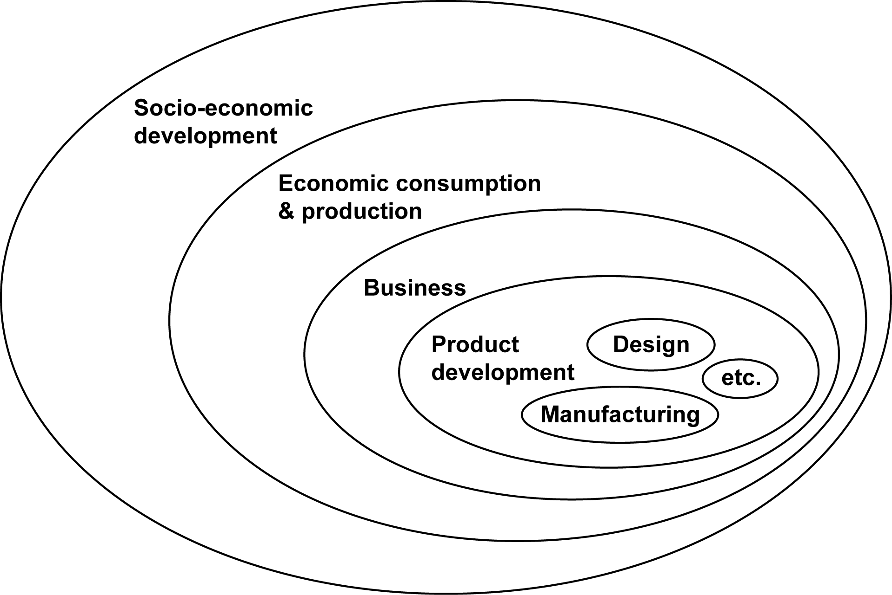
What is sustainability?
sustainable development
sustainable consumption & production
sustainable business/ corporate sustainability
Sustainable technical systems?
sustainable product development

Slide 4
What is sustainability?
the ability to sustain
literal interpretation
the ability to continue
closely related
the ability to maintain something
the ability to be maintained by something
behaviour for sustainability
behaviour meets sustainability performance criteria
our research
the ability to maintain something, with respect to these criteria

Slide 5
Applications of sustainability
sustainability in engineering design
focus area
sustainable design
sustainable engineering
sustainability of consumerism
different domains
design activity & design output
system function/ system output
product value
different targets to be maintained
Research in DMEM at the University of Strathclyde

Slide 6
The S-Cycle model - overview
systems exhibit behaviour for sustainability
the S-Cycle describes the material and energetic aspects of behaviour that affect technical system sustainability (i.e. that we should measure)
generic → applicable to different technical systems
general concepts of activity and system form the foundation of the model…

Slide 7
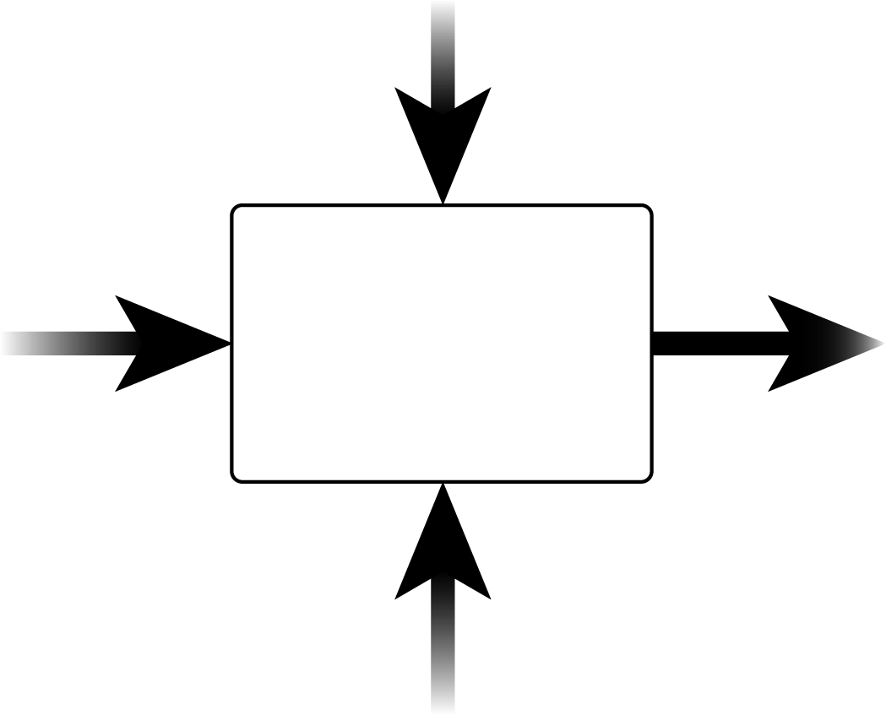
Activity
Provides a way to represent the behaviour of a technical system, e.g. a compressor…
e.g. pressure & flow rate of refrigerant
e.g. flow of refrigerant to a condenser (O)
goals
inputs
output
e.g. electricity, refrigerant, oil
compress refrigerant
e.g. heat energy (W)
activity
W
mechanisms
...technical systems produce waste (W) as well as their intended output
mechanisms
...use inputs to produce an intended output (O) that satisfies the goal of the activity
e.g. compressor & oil system, human operators

Slide 8
Activity
Across the life cycle:
Operation phase:
e.g. direct inputs + indirect inputs of biomass-derived energy for extraction, manufacturing & recycling
e.g. direct inputs of biomass-derived energy
system goals
renewable resources (R)
e.g. flow of refrigerant to a condenser (O)
(R)
goals
e.g. direct inputs + indirect inputs of fossil-derived energy for extraction, manufacturing & recycling
inputs
output
e.g. waste materials & energy from extraction, manufacturing & recycling
e.g. direct inputs of fossil-derived energy
non-renewable resources (NR)
compress refrigerant
e.g. heat energy (W)
(NR)
mechanisms
...resources may be renewable (R) or non-renewable (NR)
e.g. components produced using fossil fuels
(R)
renewable resources (R)
e.g. human operators
(NR)
non-renewable resources (NR)
e.g. obosolete components
e.g. components produced using renewable energy

Slide 9
Activity
...additional goals for system sustainability
system goals + sustainability goals
e.g. direct inputs of biomass-derived energy
system goals
e.g. flow of refrigerant to a condenser (O)
(R)
goals
inputs
output
e.g. direct inputs of fossil-derived energy
compress refrigerant
e.g. heat energy (W)
(NR)
IR
e.g. oil re-injected to compressor (IR)
mechanisms
...should not be produced faster than it can be processed
...should not be used
...should not be used faster than stocks can regenerate
...the technical system may also produce its own resources (intended resources, IR)
(R)
e.g. human operators
(NR)
e.g. obosolete components

Slide 10
System
All technical systems operate within a wider system of interest…
…that provides resources…
For example…
system goals + sustainability goals
system of interest
a ship at sea
the global ecosystem
RR
goals
O
inputs
output
NRR
compress refrigerant
activity
W
mechanisms
IR
…and receives intended output and waste.
non-renewable resource stocks
e.g. the stock of equipment on board the ship
natural NRR stocks e.g. crude oil, coal & natural gas deposits
NRR
natural RR stocks e.g. forests, oceans, the atmosphere
renewable resource stocks
e.g. stocks of oil & refrigerant on board, the sea & atmosphere
RR

Slide 11
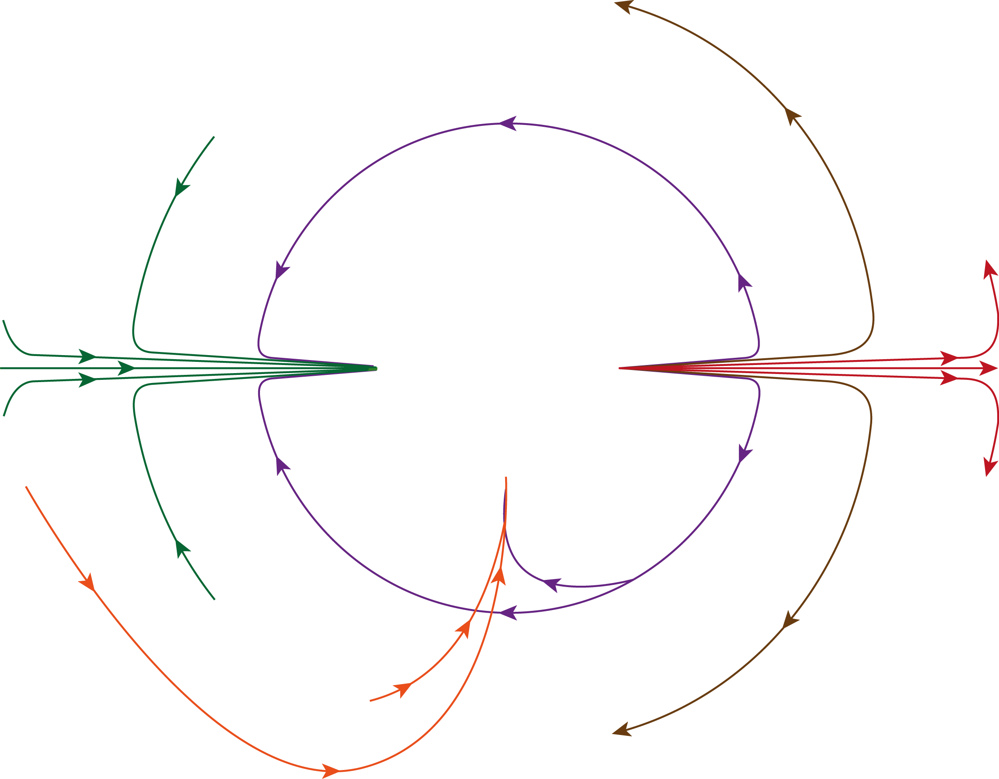
System
Resources and waste flow throughout the system of interest…
IR
system of interest
RR
system goals + sustainability goals
O
NRR
goals
inputs
output
activity
mechanisms
O
RR
IR
NRR
RR
non-renewable resource stocks
renewable resource stocks

Slide 12
S-Cycle model
IR
system of interest
RR
system goals + sustainability goals
O
NRR
goals
inputs
output
activity
mechanisms
O
RR
IR
NRR
RR
non-renewable resource stocks
renewable resource stocks

Slide 13
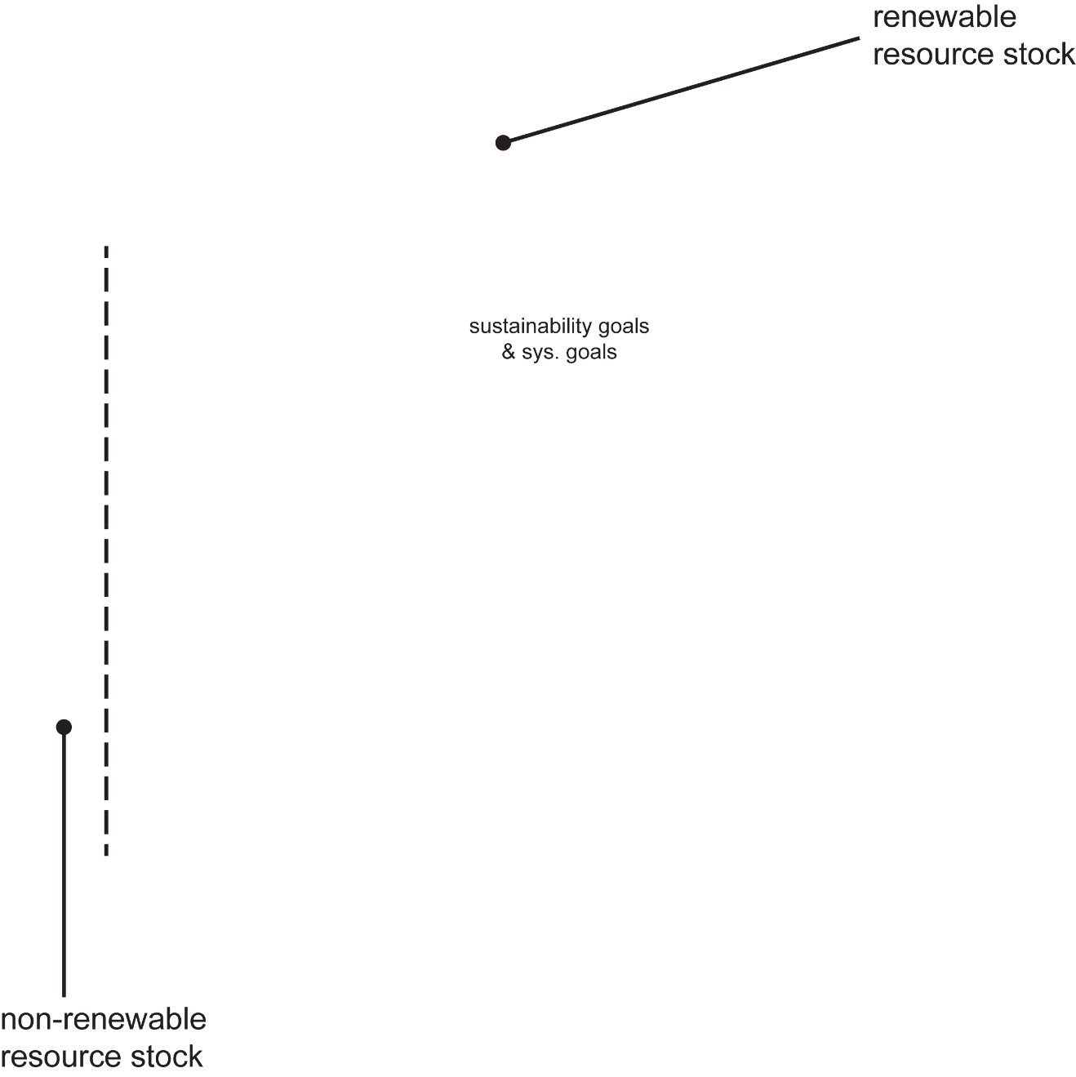
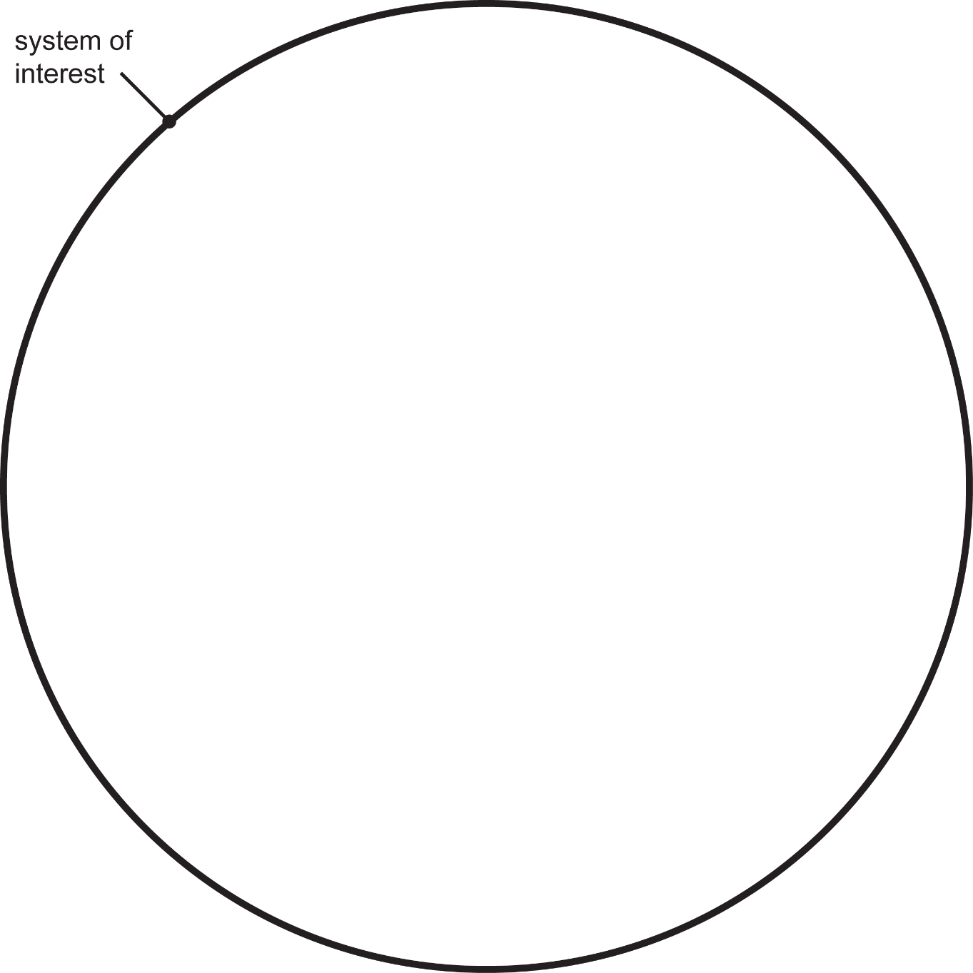
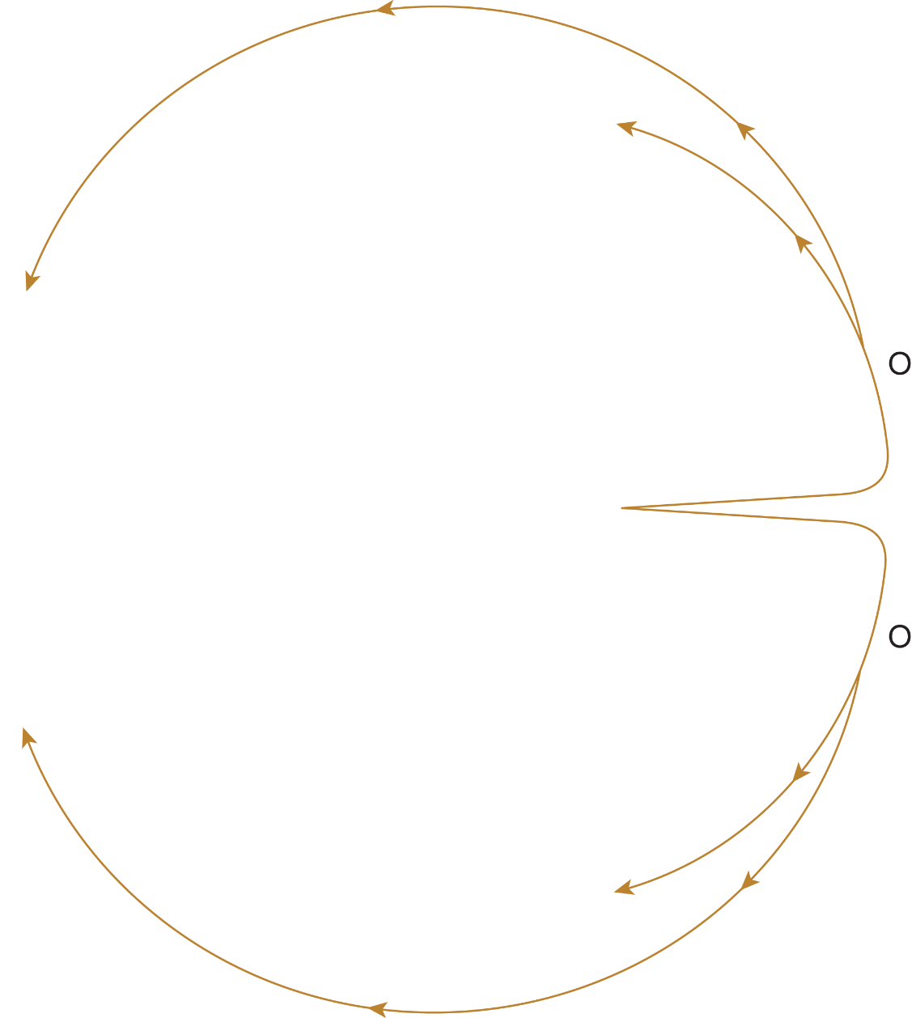
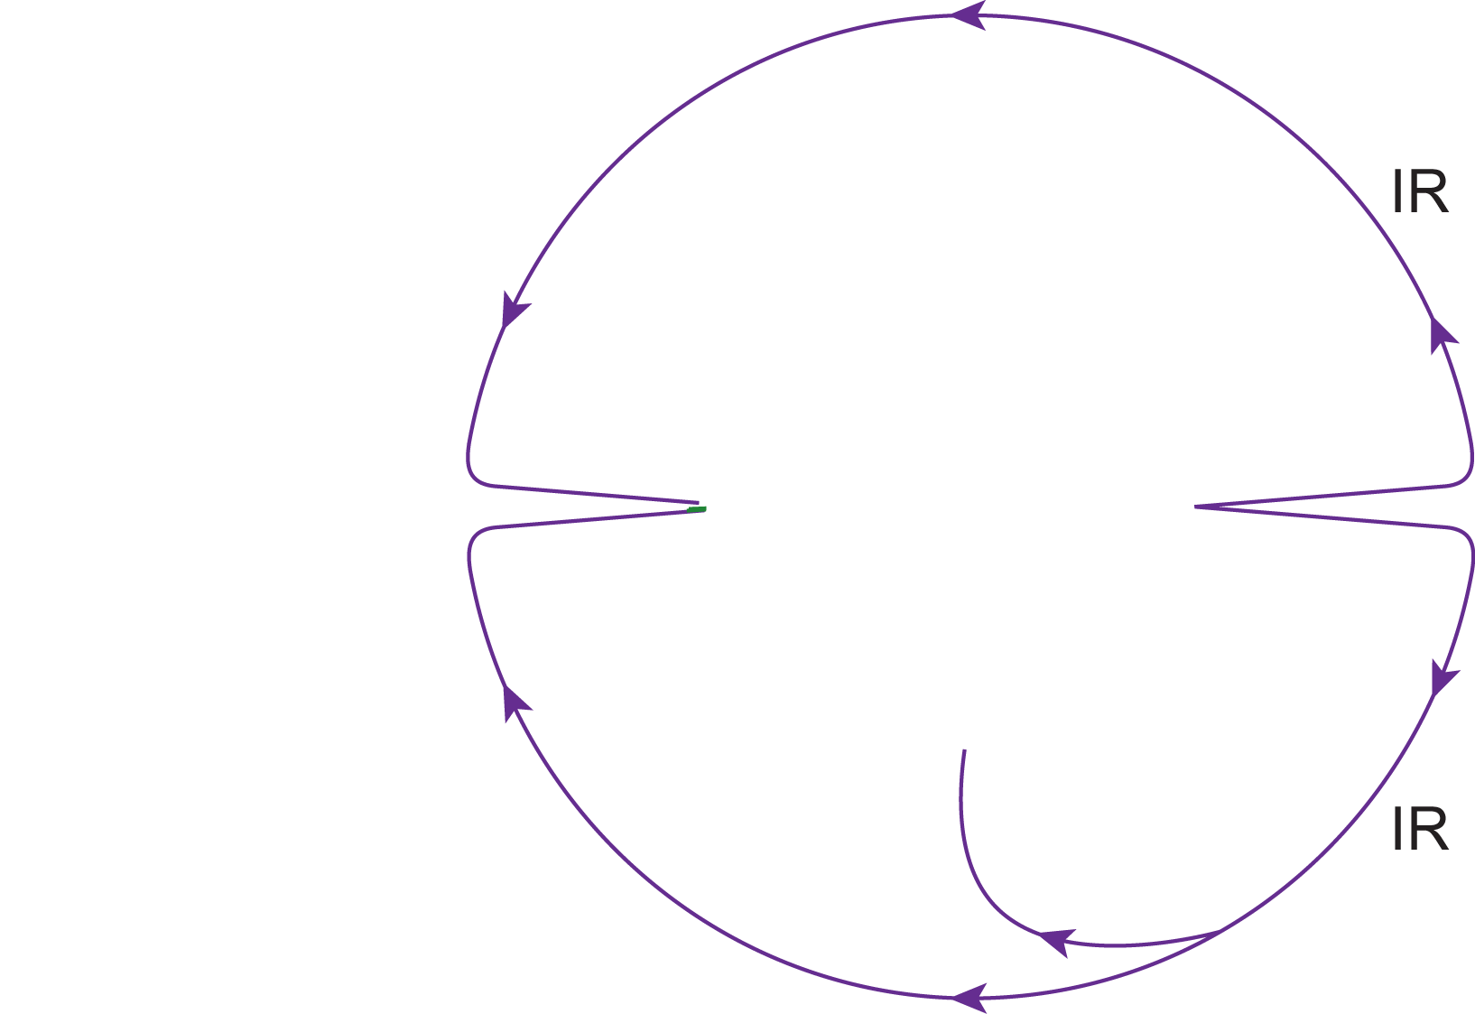
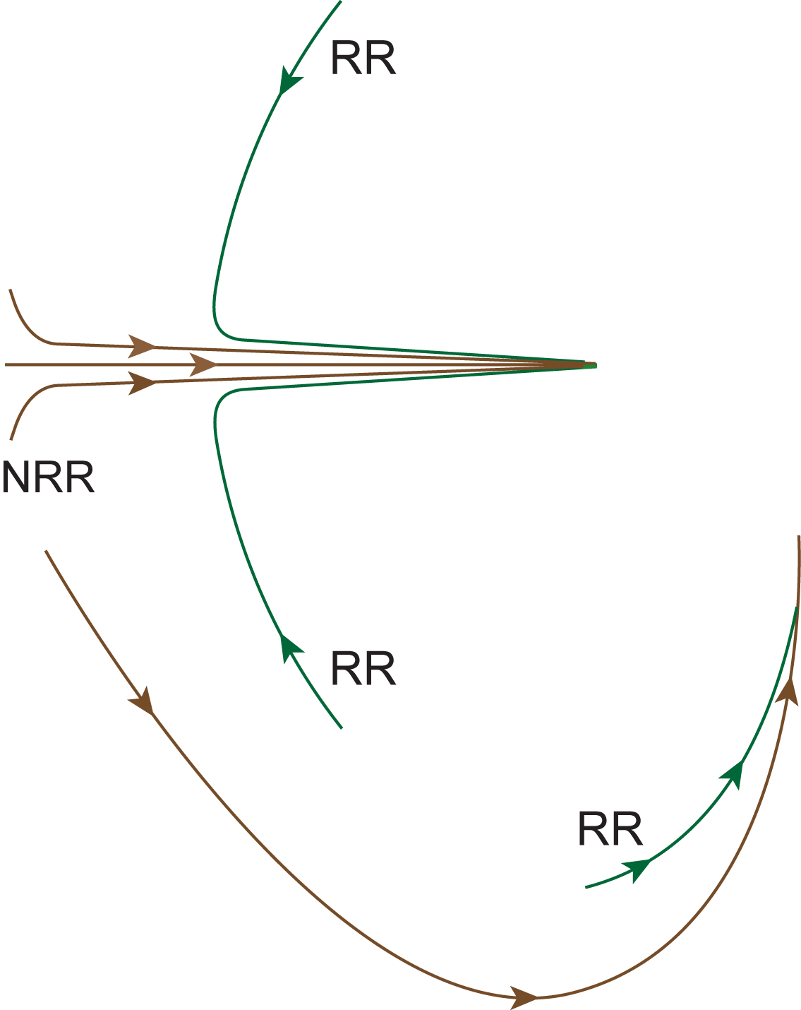
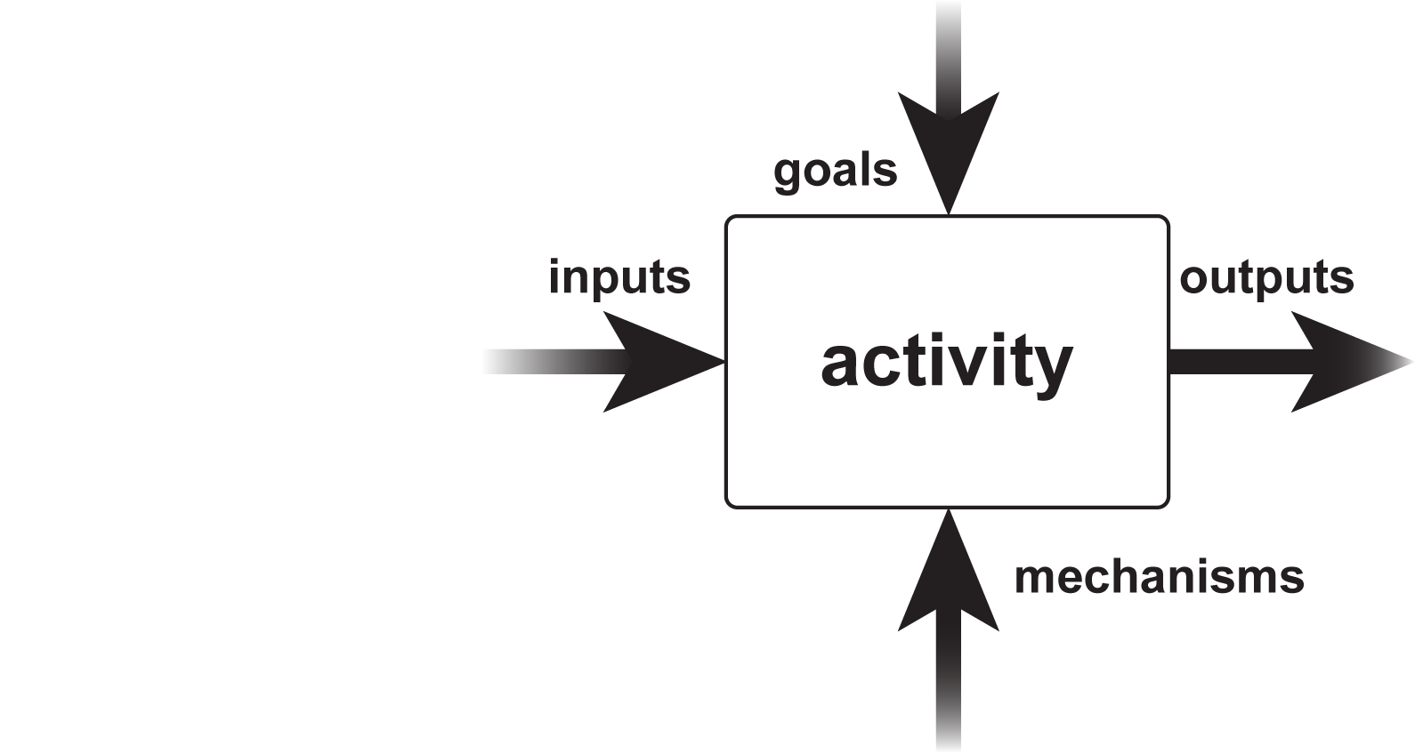
The S-Cycle model - recap
The S-Cycle supports the modelling & assessment of a technical system’s behaviour…
…what renewable (RR) and non-renewable (NRR) resources are required?
…what resources are produced for self-support (intended resources, IR)?
…within the boundary of a particular system of interest…
To sustain the production of intended output (O) over time…
…and what waste (W) must be mitigated?
…from a sustainability perspective.

Slide 14
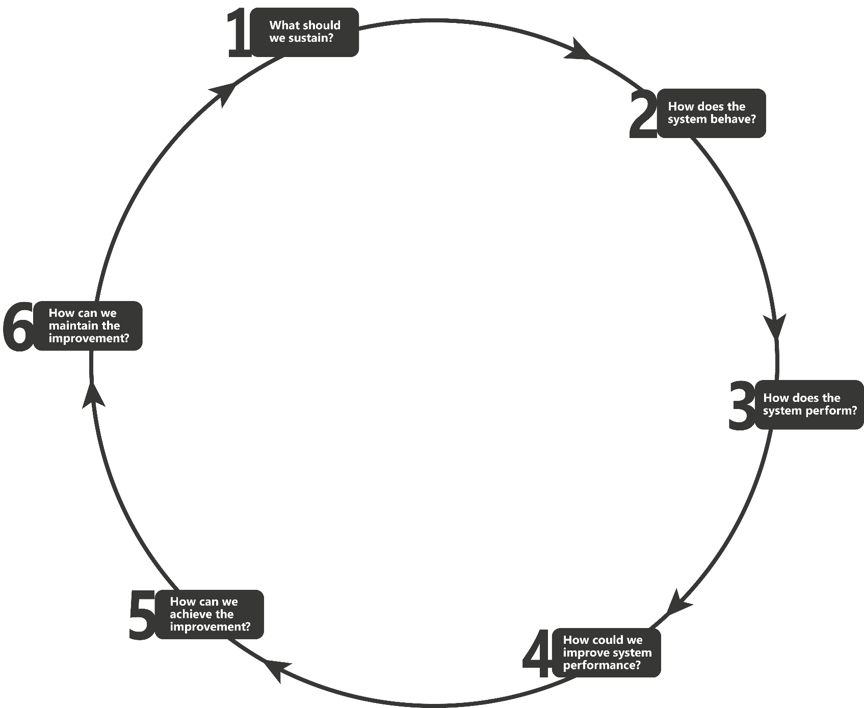
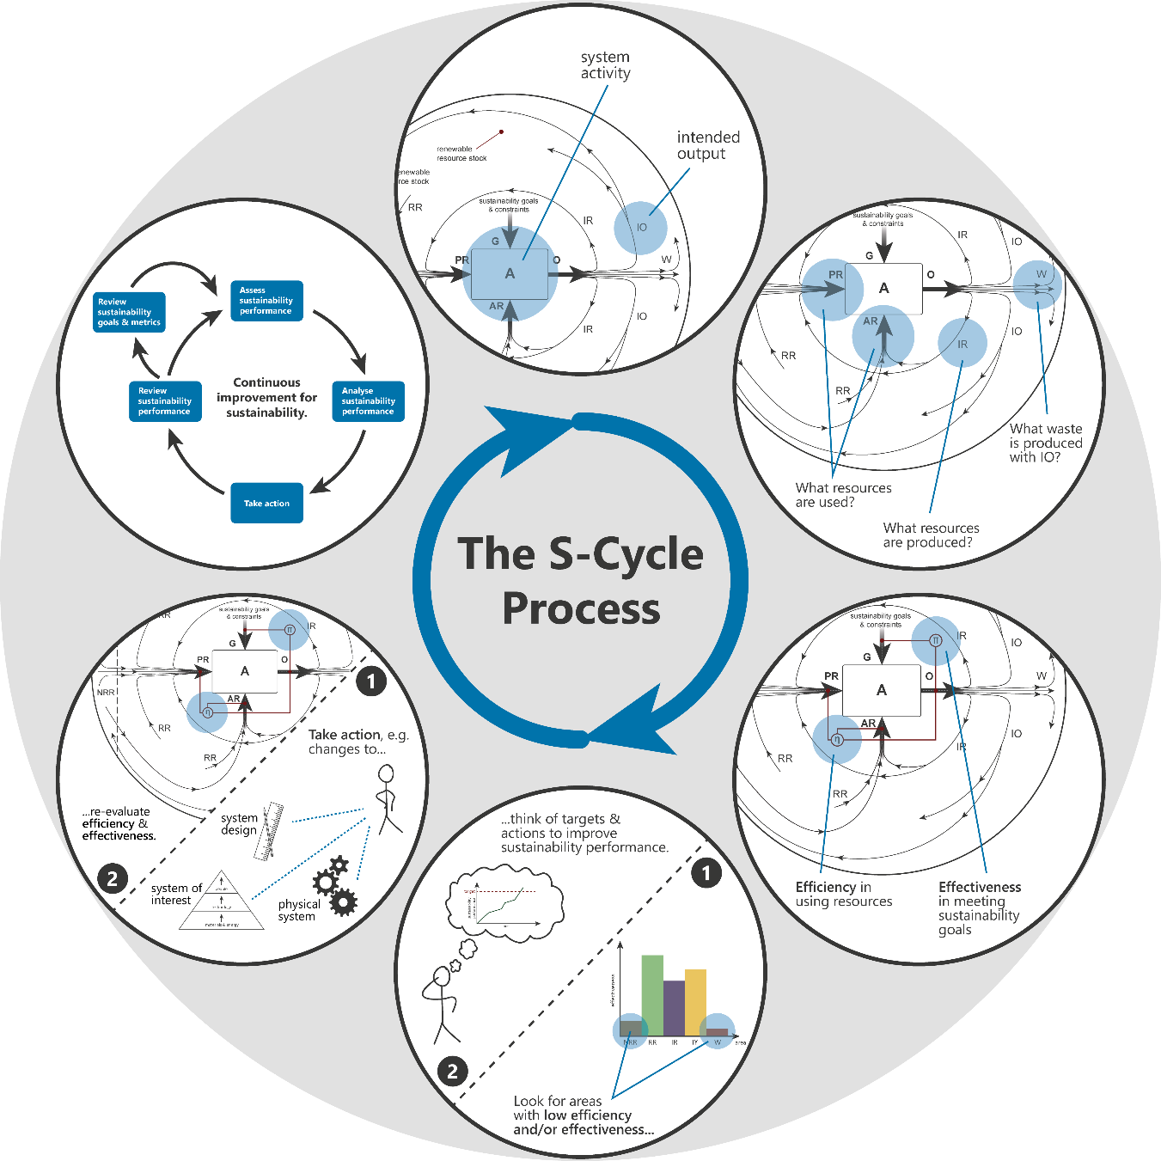
S-Cycle Performance Improvement Process
review
modelling
action
performance assessment & analysis

Slide 15
S-Cycle case studies
S-Cycle model applied to model and interpret the behaviour of the chilled water (CW) system on a ship (case study 1).
Model of system behaviour used as a basis to (case study 2):
identify sustainability goals and metrics for the CW plant sub-system
develop a quantitative model to estimate CW plant performance
CW plant sustainability performance evaluated, and potential areas for improvement identified.
Steps 1 – 4 of the S-Cycle Performance Improvement Process (modelling & assessment/analysis.
Focused on a portion of the operation phase of the life cycle – ship operational at sea.

Slide 16
Modelling behaviour – IDEF0
CW system activity:
goals
inputs
outputs
materials & energy
Remove waste heat from equipment aboard the ship
activity
mechanisms
CW system equip., human operators
IDEF0 language applied to decompose activity/sub-activity relationships.

Slide 17
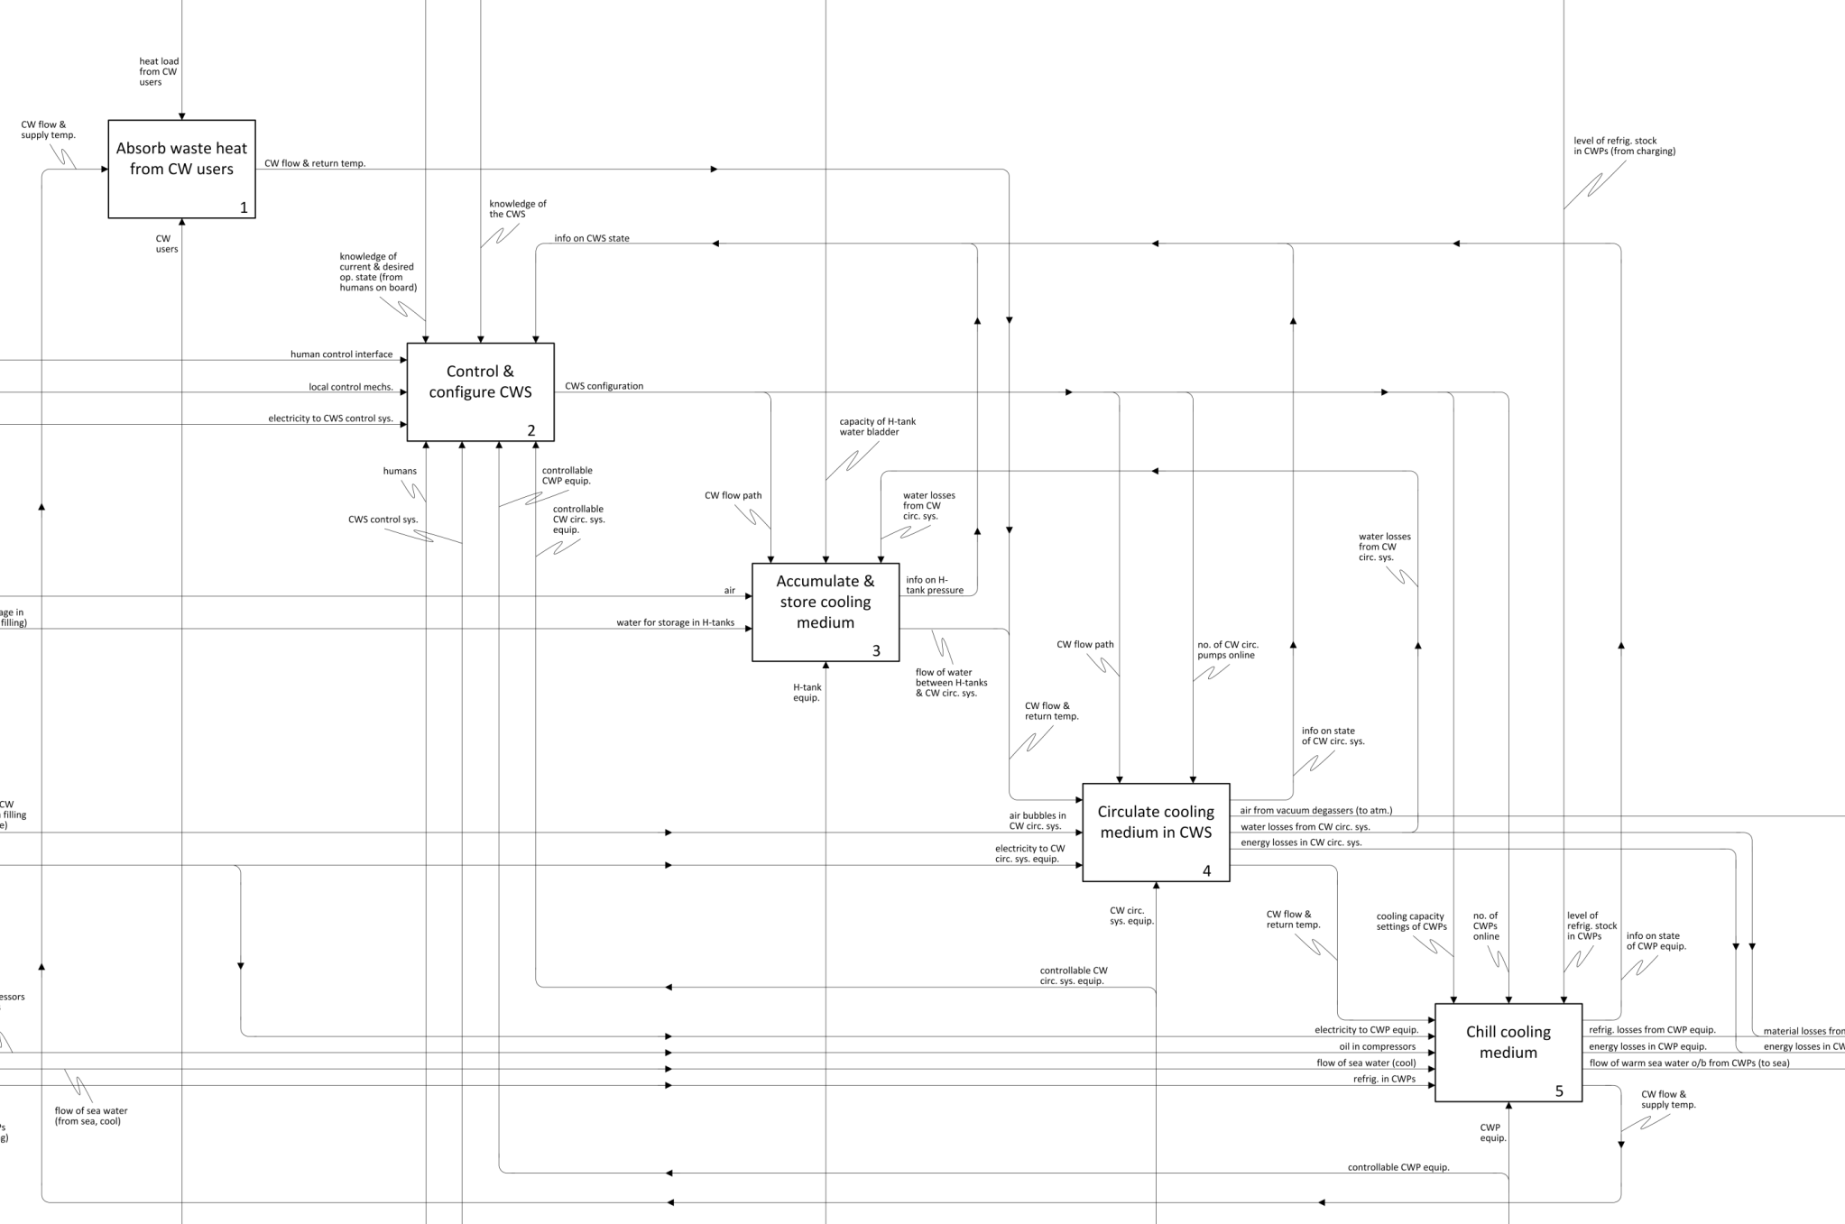
Controls (conditions that govern the outputs)
Sub-activities
Activity
Outputs
Inputs
Coupling relationships
Mechanisms

Slide 18
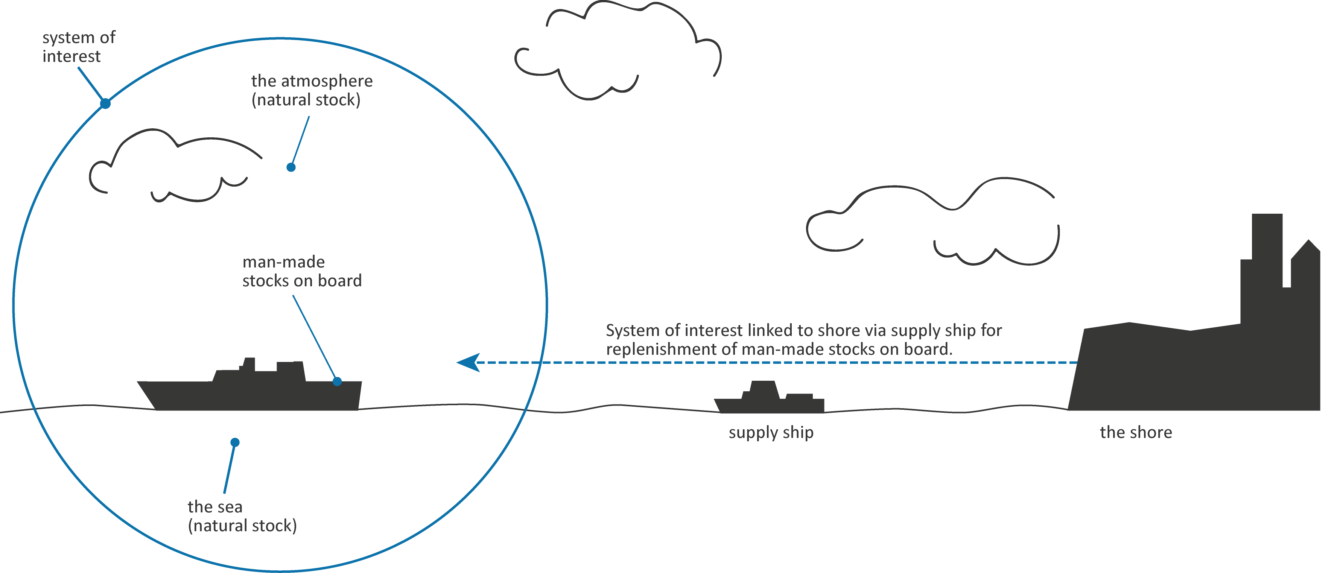
Interpreting behaviour

Slide 19
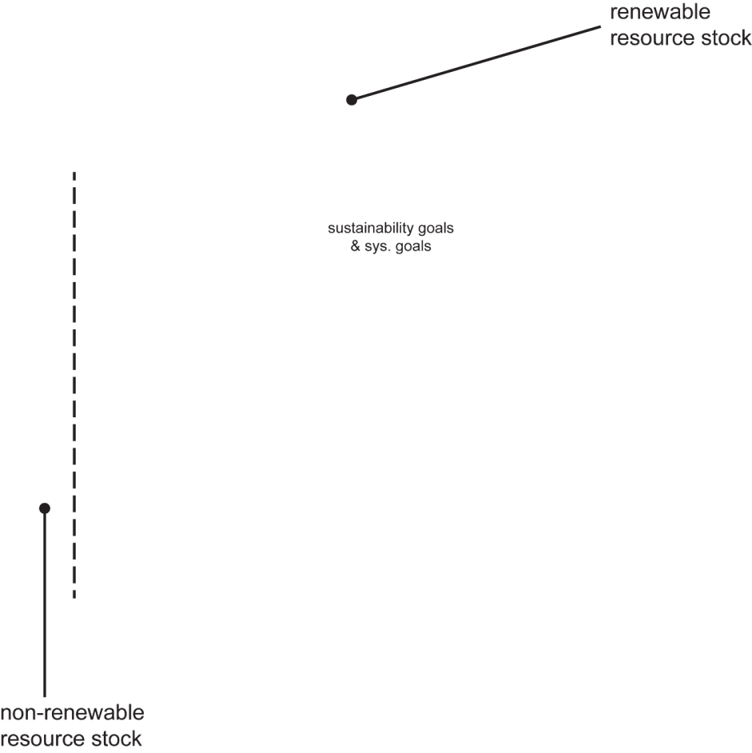
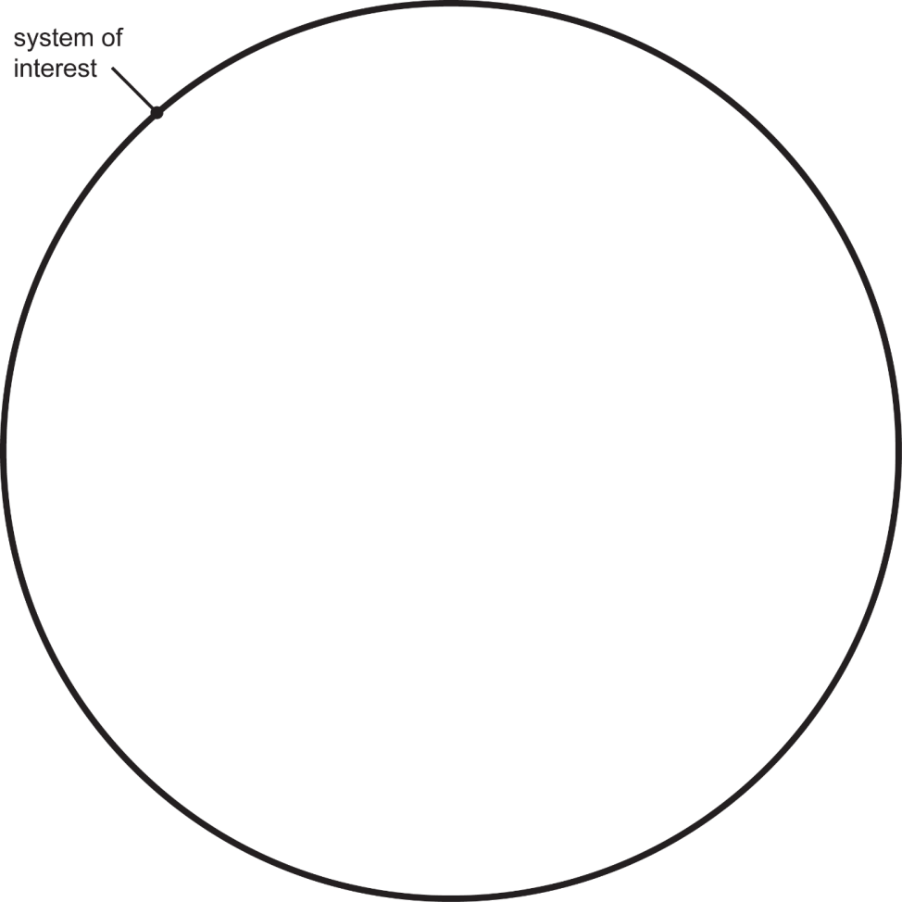
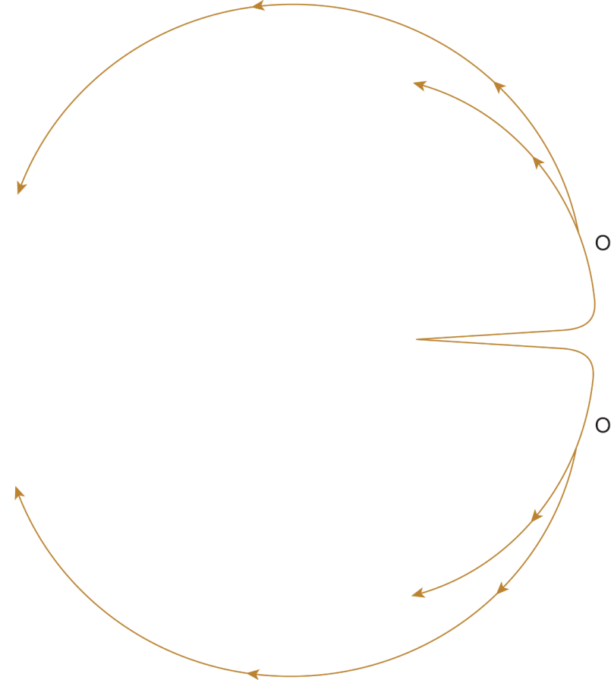
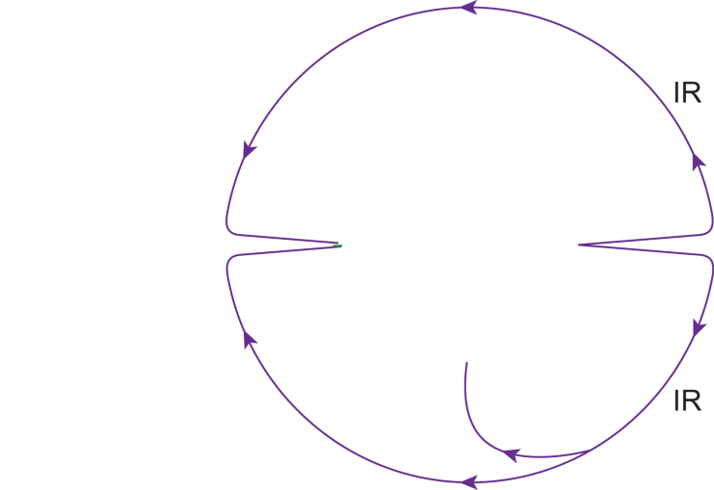
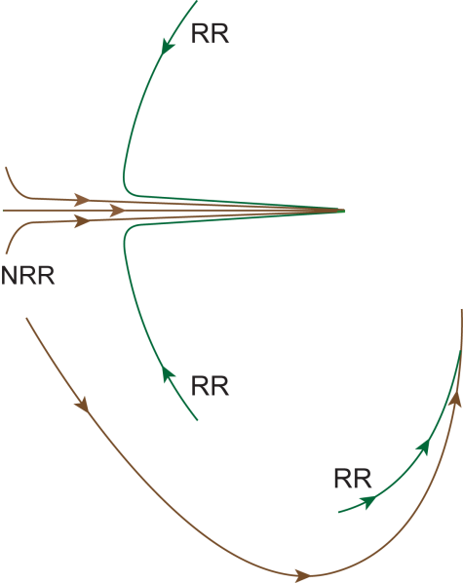
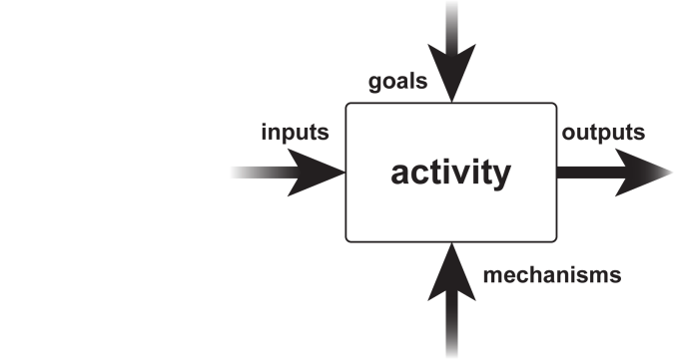
Interpreting behaviour
Resource stocks = the sea & atmosphere (natural), and stocks on board the ship (man-made)…
…i.e. the stocks available whilst the ship is at sea.
ship at sea
…to classify the inputs, outputs & mechanisms as renewable, non-renewable & intended resources, intended outputs, or waste.
The S-Cycle was applied to each activity in the CW system model…
Remove waste heat

Slide 20
Interpreting behaviour
Excerpt from interpretation…
IDEF0 Diagram | Activity | Renewable resources | Non-renewable resources | Intended resources | Intended outputs | Waste
A0 | Absorb waste heat from users | CW flow & supply temp. (Iª) | CW users/CWS heat exchange mechs. (M^{b}) | ----------------------- | CW flow & return temp. (O^{c}) | -----------------------
A0 | Control & configure CWS | Electricity to CWS control sys. (I) | Human control interface (I) | ----------------------- | Informational → excluded | -----------------------
 |  | Humans (M) | Local control mechs. (I)
 |  |  | CWS control sys. (M)
 |  |  | Controllable CWP equip. (M)
 |  |  | Controllable CW circ. sys. equip. (M)
A0 | Accumulate & store cooling medium | Air (I) | H-tank equip. (M) | ----------------------- | Flow of water between H-tanks & CW circ. sys. | -----------------------
 |  | Water for storage in H-tanks (I)
A0 | Circulate cooling medium in CWS | CW flow & return temp. (I) | CW circ. sys. equip. (M) | ----------------------- | CW flow & return temp. (O) | Air from vacuum degassers (O)
 |  | Electricity to CW circ. sys. equip. (I) |  |  |  | Water losses from CW circ. sys. (O)
 |  |  |  |  |  | Energy losses in CW circ. sys. (O)
A0 | Chill cooling medium | CW flow & return temp. (I) | CWP equip. (M) | ----------------------- | CW flow & supply temp. (O) | Refrig. losses from CWP equip. (O)
 |  | Electricity to CWP equip. (I) |  |  |  | Energy losses in CWP equip. (O)
 |  | Oil in compressors (I) |  |  |  | SW flow & reject temp. (O)
 |  | SW flow & supply temp. (I)
 |  | Refrig. in CWPs (I)
A511 | Compress flow of refrigerant from evaporator | Flow of refrig. in suction line (I) | Compressor & oil circuit (M) | Oil re-injected to compressor | Flow of refrig. from compressor (O) | Energy losses in compressor (O)
 |  | Electricity to compressor (I)
 |  | Oil in CWP 1 compressor (I)
operation phase → direct inputs and outputs only
majority of material and energetic inputs interpreted as renewable since replenishable at sea
majority of physical equipment comprising the system interpreted as non-renewable since not fully replenishable at sea (partially owing to spares)
a single example of intended resources identified, i.e. oil re-injected to compressor crankcase inside CW plants
waste – mainly due to material leaks (e.g. refrigerant and water), and energy losses (e.g. heat and vibration)
identified an additional type of input not included in the first version of the model – contaminants, inputs detrimental to sustained production of intended output

Slide 21
Identifying sustainability goals & metrics
Masters project focusing on performance of CW plant sub-system during design process…
Minimise of use resources that are harmful to the environment
Maximise intended resources?
Minimise cost of intended output (sustainable business/sustainable development goal)
Minimise production of waste

Slide 22
Assessing sustainability performance
Metrics and measures defined to assess system performance against each goal…
Test data, data from quantitative model, and benchmarking used to evaluate metrics & measures…
…metric values analysed to identify areas for improvement (primarily reduction in diesel consumption associated with electrical input).

