Slide 1
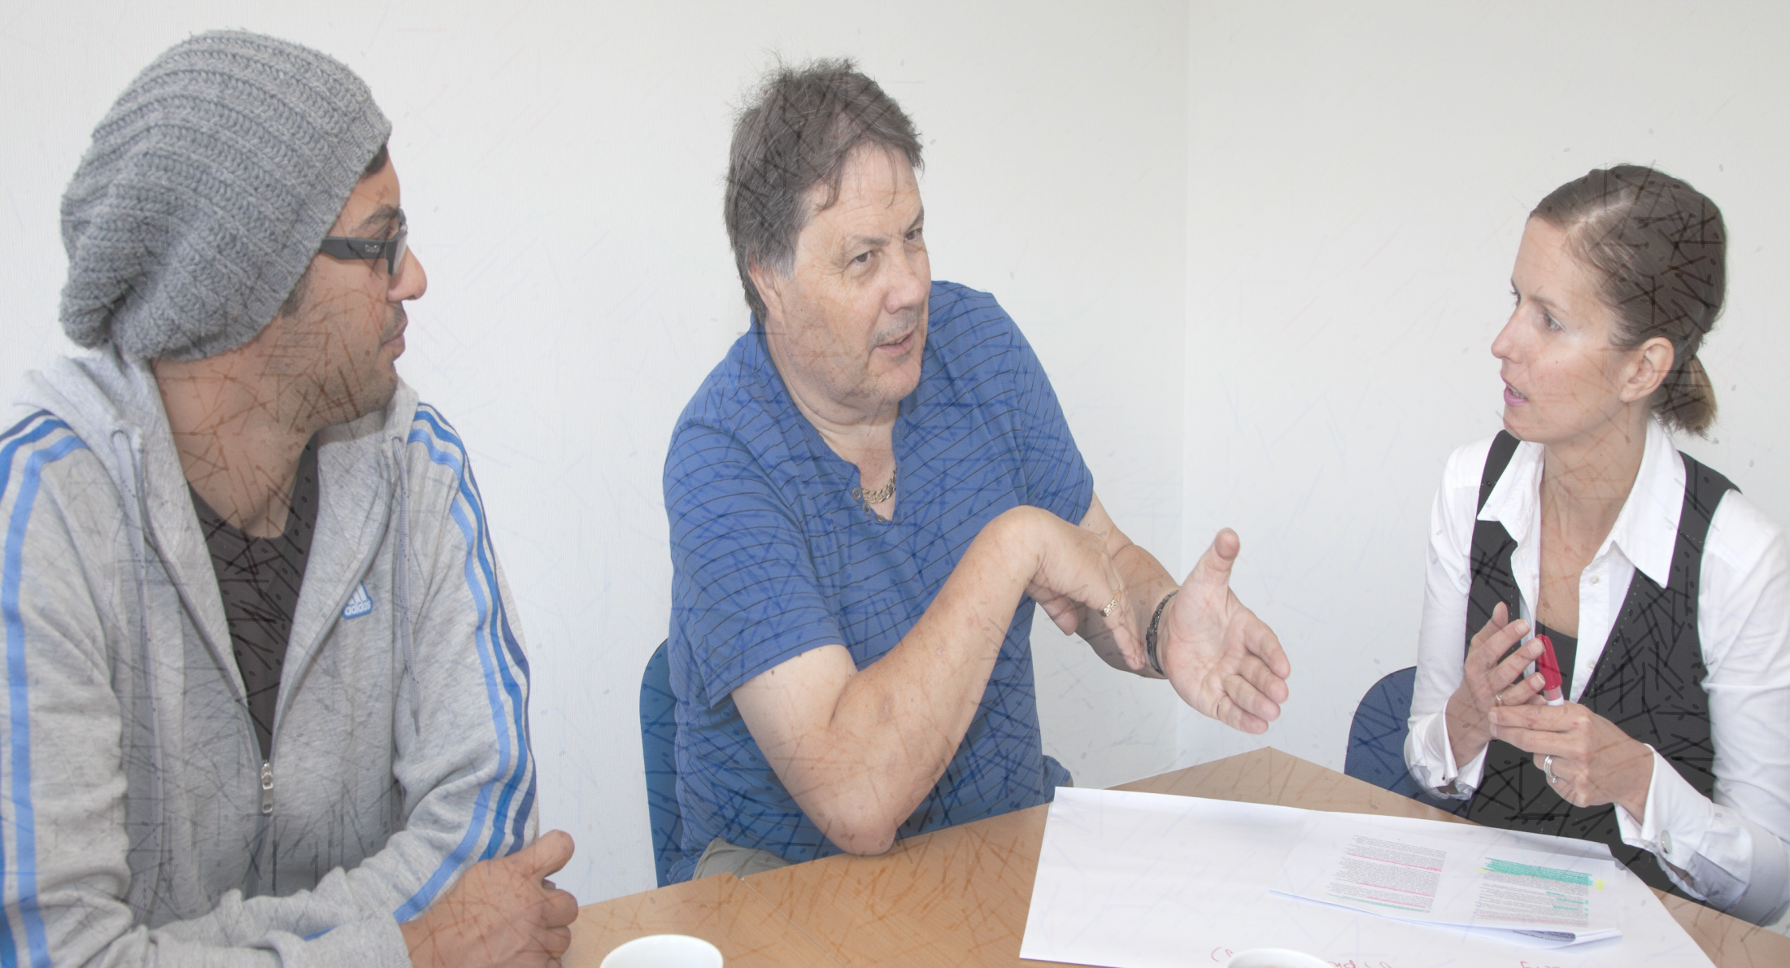


Tackling unemployment for blind and partially sighted people
Summary findings from a three-year research project (ENABLER)
City University London,
Disability and Social Inclusion
Seminar
Alex Saunders, RNIB and Dr Paul Lynch, University of Birmingham
16/06/15

Slide 2
Introduction
Background to the project
Methodology
How we delivered the research
What we found
What we produced
Post-project impact
Questions and discussion

Slide 3
Introduction
Between 2010 and 2013, RNIB, Action for Blind People (Action) & University of Birmingham carried out 3 year, action research project to help improve the employment prospects of blind and partially sighted people
Working alongside a group of internal and external employment specialists and approximately 100 blind and partially sighted people, we designed and tested:

Slide 4
Introduction
A standard assessment model to increase our understanding of the skills, aspirations and barriers to employment of blind and partially sighted people
Innovative support strategies for those furthest from the labour market, helping inform how we deliver services for blind and partially sighted people seeking work

Slide 5
Employment rates
Approximately 84,000 registered blind and partially sighted people of working age in the UK (HSCIC 2014)
According to the Labour Force Survey , approximately 113,000 people consider themselves as "long term disabled with a seeing difficulty" (Hewett with Keil, 2014)

Slide 6
Employment rates
33% of registered blind and partially sighted people were in employment (Clements and Douglas 2009), compared with 77% of the general population
45% of people "long term disabled with a seeing difficulty" were in employment, compared with 73% of all people of working age (Hewett with Keil, 2015)

Slide 7
Employment rates
Well documented that blind and partially sighted people experience considerable difficulties in obtaining and retaining work
Despite DDA, Equality Act; various government initiatives such as Access to Work, New Deal for Disabled People, Flexible New Deal and so on

Slide 8
Employment rates
Existing Welfare to Work provision supports most effectively those people who are closest to the labour market
Current provision has little impact on those clients who could be considered hardest to help. Many blind and partially sighted people fall in to this category
Work Programme - helped just 60 (6%) of the 1,010 blind or partially sighted people enrolled on the programme since June 2011

Slide 9
Employment rates
Highlighted a need for renewed thinking and a clearer understanding of our clients' barriers and associated issues
And the need for new and effective assessment tools and working practice that support a wider client base
The ENABLER project, 2010-2013

Slide 10
Project research questions
Is there a segmentation model to support the understanding of the needs and barriers of blind and partially sighted people?
How can we assess unemployed blind and partially sighted people in a way that identifies individual barriers and highlights potential support needs that will move people closer to their employment potential?

Slide 11
Project research questions
3. Will this wider understanding and the development of targeted interventions enable us to support more blind and partially sighted people move closer or into the open labour market?
4. What are the most appropriate interventions that can support this journey?

Slide 12
Project research questions - the segmentation model
Level 1
Work entry clients
10%, 5,000 people
Job brokerage, soft-skill development
Level 2
Transitional clients
15%, 7,500 people
Structured daily work-related
training and assessment
Level 3
Long-term clients
25%, 12,500 people
Social and personal skills development
Level 4
Potential clients
50%, 25,000 people
Re-engagement strategies,
daily living skills,
supported employment

Slide 13
Theoretical Framework
WHO ICF – useful vocabulary - nature of an individual’s impairment, how they travelled (activity), the purpose of their journeys (participation) and so on
An interactional approach – range of factors to improving lives of blind and partially sighted people through interventions (coaching, anti-discrimination and attitudinal change, better benefits and services, etc.) Shakespeare, 2006

Slide 14
Redressing the balance between medical and social aspects
Functioning in an ordinary way without getting special attention or being singled out as a result of disability
Mixing with others and not being ignored in friendship and networks
Taking part in and contributing to society whether through paid work or volunteering.
Trying to realise one’s potential – which may need help from others
Being director of one’s life (locus of control)

Slide 15
Inclusive approaches and specialist knowledge
Many aspects of employment services are relevant for all people seeking work or voluntary work, but there are some aspects which are particularly pertinent or important for blind and partially sighted people.
The focus of our work involved identifying the specialist areas in increasing opportunities for employment and ensuring that they are not lost in the services that blind and partially sighted people receive.

Slide 16
Methodology
Two research opportunities (challenges):
1. Including the views of the people the research is intended to support in the design and running of the project (participatory action)
2. ensuring the outcomes from the research are relevant and positive for those participating

Slide 17
Methodology: Action research
Action research approach - bringing clients and employment advisers together to change their situations through:
reciprocity - engaging people from the start of the research planning and design, right through to implementation
consultative - iteratively designing and revising assessment tool (bottom-up approach – clients and employment advisers)

Slide 18
Methodology: Research cycles
First cycle - testing the developing assessment tool in the field - analysis of impact and correlations between experiences
Second cycle - further refinement of the assessment tool, plus development of specialist interventions
Final iteration - findings from the research disseminated and applied
Key principle: employment advisers and clients shaping the design of the assessment tool and specialist interventions

Slide 19
Designing the assessment tool
Review of 2000 records for indicators of most important factors in determining progress towards employment
Focus groups with employment advisers from each Action region
Client focus group
Analysed existing record keeping and assessment tools being used across Action / RNIB

Slide 20
Designing the assessment tool
Reviewed other measurement tools (Outcome Star, Rickter Scale) - concluded a bespoke assessment model was required, tailored specifically for blind and partially sighted job seekers
Sent drafts for consultation with employment advisers / other stakeholders / client forums

Slide 21
Assessment Tool: Computer skills
These questions are about computers and assistive technology. At the end is a chance to reflect upon the implications of this and the previous section upon the action plan.
Q26: Ask your client: "Overall, would you say you were a confident computer user?" | On a scale of 1 to 6, if 6 is "very confident" and 1 is "not at all confident". | Answer (1-6):
Q27: Does your client have access to a computer that they can use on a daily basis? | Answer yes or no. | Answer (yes/no):
Q28: Does your client use a computer without any additional access technology? | Answer yes or no. | Answer (yes/no):
Q29: Does your client use a computer with some additional changes (for example, using Windows accessibility options to increase font size, size and colour of cursor)? | Answer yes or no. | Answer (yes/no):
Q30: Does your client use a computer with screen magnifier software (for example, Supernova, ZoomText, Lunar)? | Answer yes or no. | Answer (yes/no):
Notes:
the employment adviser to evaluate level of need. Interview is not the place to ask them to demonstrate skills but get an overall sense of individual current capabilities and specific needs.

Slide 22
Trialling the assessment tool
First trial - in all Action regions, Loughborough College, Trainee Grade Scheme and RNIB Scotland, involving over 60 clients and 18 employment advisers in March 2011

Slide 23
Trialling the assessment tool
Consultative / participatory: the assessment tool is a reflection on good practice
Worked closely with employment advisers and blind and partially sighted people, drawing upon their expertise to design, test and revise the assessment tool
Testing the toolkit 'in the field' - learn through practice what was / wasn't working
Ensured the practical requirements of the assessment tool were considered carefully

Slide 24
First trial data collection
First application of assessment tool
Focus group with employment advisers (4 months after launch)
Second application of assessment tool
Client interviews – reflect on services, not a monitoring exercise of employment advisers
Other data sources – internal database (action impact
Important – first trial was ‘voluntary’

Slide 25
Trialling the assessment tool
Encouraging response amongst advisers and clients - both were positive about the broad approach
Between the first and second trial of the assessment tool
Stakeholder group / additional employment adviser focus group / client representation at the steering group
Further revisions before the second trial

Slide 26
Trialling the assessment tool
7 employment advisers, 14 clients - testing new interventions - March 2012 for 10 months
Key – the assessment tool became the main source of assessment and action planning
Buy employer adviser – to trial the assessment tool
Also, this was the part of the research during which we trialled new interventions with clients

Slide 27
Second trial data collection
Employment adviser diaries
Client dairies
Catch-up interviews via phone
Three one-day workshops with employment advisers
Bi-monthly meetings between employment advisers and senior management, as well as project sponsor
Final telephone interviews with clients

Slide 28
Second trial data collection
The assessment tool
- at the beginning and at the end of the trial (mirroring what would happen in practice)
Employment coordinator logs

Slide 29
Measuring progress
Client is now employed
Client is now engaged in meaningful employment-focussed activity (unsupported voluntary placements, job applications and interviews)
Client is now engaged in an educational programme which leads to a qualification
Client / employment adviser judge skills have improved following engagement in informal skills-based training (eg pre-employment programme)

Slide 30
Measuring progress
Client / employment adviser judge skills have improved following engagement in informal supported work activities
Client / employment adviser judge life has improved following intervention in relation to foundation areas: security, safety and general welfare
Client has shown little or no progress in relation to any of the above evidence

Slide 31
What we found
We identified key factors that determine a blind or partially sighted person’s distance from the labour market, and whether they are ready for work.
Examples of those factors include:
being able to self-advocate to employers, explaining what workplace adjustments will be required to carry out particular roles

Slide 32
What we found
confidence and competence using computers adapted with appropriate assistive technology software
confidence and ability to travel independently using public transport
access to information via a preferred format of braille, large print, audio or electronic information

Slide 33
What we found
We have shown that blind and partially sighted people furthest from the labour market require intensive support and specialist interventions in key areas.
These include:
developing assistive technology skills
developing mobility skills

Slide 34
What we found
Developing skills to communicate needs and associated adjustments to employers
making the most of residual vision
a pre-employment programme, designed to meet the complex needs of blind and partially sighted people

Slide 35
What we produced
We have developed a comprehensive employment assessment toolkit that takes account of the specific needs of blind and partially sighted job seekers.
The toolkit enables employment advisers, who work with blind and partially sighted people to gain a clear understanding of their clients’ aspirations in relation to employment, and what types of support and development are required

Slide 36
What we produced
Two related approaches:
1. Questions designed to generate assessment information which help the employment adviser / client design an action plan (based on what both have said are important)
Includes information that provides a context, such as level of vision and general health

Slide 37
What we produced
2. Some questions have a useful screening function
Answers to some of the questions can be combined to enable the client to be assigned one of 5 levels
The assigned level can help communicate to clients the steps they need to take to progress towards paid employment
Communicate progress over time

Slide 38
What we produced
Made up of seven main areas:
Employment activity
Current job search activity
Access to information
Computer skills
Independent travel
Vision
Health related issues
Target Job

Slide 39
What we produced
Level 1 – Work ready
Level 2a – Nearly work ready (closer)
Level 2b – Nearly work ready (further)
Level 3 – Longer term support needed
Level 4 – Foundation work required before employment services

Slide 40
What we produced
establish a baseline, which can be compared with a reassessment following intervention
identify and design effective interventions - ie a diagnostic tool
record evidence of measurable success towards paid employment
acknowledge and celebrate other meaningful outcomes such as greater independence, or contribution and participation through voluntary work

Slide 41
Does it work?
Clients:
"It helped me to focus on existing skills and how I can transfer these skills to a new career"
"Challenging, but I liked that…no point in asking unspecific questions but [you] need to ask questions that get to the real difficulties I'm experiencing"
"The disability employment adviser only has limited information about me so there is a need to have something more structured"

Slide 42
Does it work?
Employment professionals:
"It does highlight the importance of this approach to supporting people with sight loss. It takes them so much further towards the job market than any of the work readiness contracts"
"The last few months have definitely given us an opportunity to try many different approaches with more intensive support than we are usually able to offer"

Slide 43
Post-project impact
The new employment assessment toolkit is helping the RNIB group of charities to re-model the way it delivers pre-employment support with blind and partially sighted people
Analyse the different types of clients we support, and the effectiveness of our interventions
“This is an evidence based customer segmentation of our working age customers”

Slide 44
Post-project impact
It can be used by any provider working in the welfare to work industry that supports blind and partially sighted people
One way to bring our specialist knowledge to a wider audience, has been to share the toolkit and what we have learnt about supporting those hardest to help with other providers
To help embed this knowledge in good practice across the sector

Slide 45
Post-project impact
Sharing the toolkit with Welfare to Work providers - Shaw Trust, Ingeus
Centre for Economic and Social Inclusion - 'Fit for Purpose' and 'On the Right Track'
BASE, SUSE, EUSE conferences
Main assessment tool in Poland
Discussions with Scope
IEP and ERSA websites

Slide 46
What next
Pick up a summary report
More information at:
www.rnib/org.uk/enablerresearch
www.rnib.org.uk/assessmenttoolkit
Join RNIB Employment Practice and Research Network (EPRN)
www.rnib.org.uk/eprn

