Slide 1
Commission on Hearing Loss – Final Report
Paul Breckell
Chief Executive, Action on Hearing Loss

Slide 2
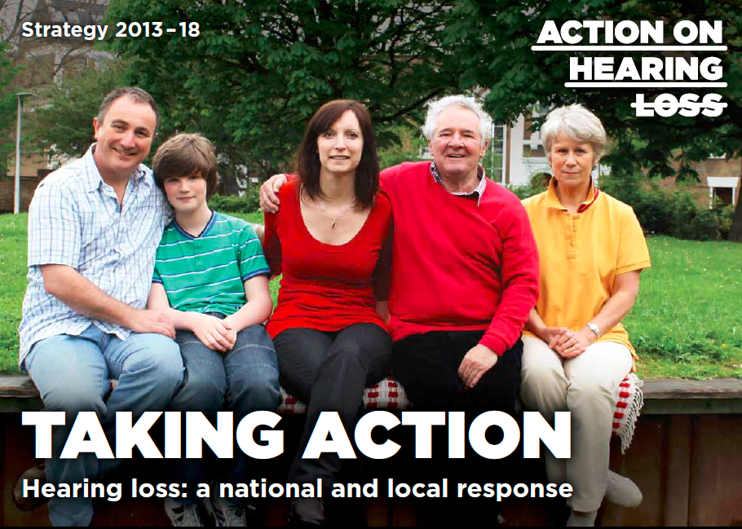
WHO WE ARE
We’re the charity working for a world where hearing loss doesn't limit or label people, where tinnitus is silenced – and where people value and look after their hearing.

Slide 3


what we do and our goals
We help people confronting deafness, tinnitus and hearing loss to live the life they choose.
We enable them to take control of their lives and remove the barriers in their way.
We give people support and care, develop technology and treatments, and campaign for equality.

Slide 4
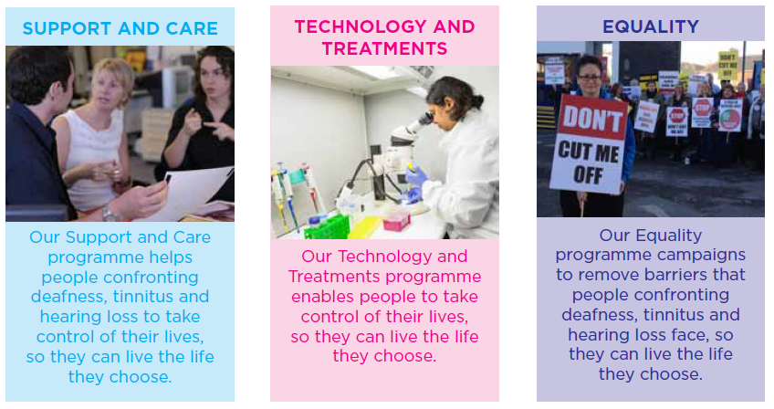
STRATEGIC programmes
Notes:
Our plans are split into three programmes.
A team of people from different parts of our organisation leads each programme and makes sure we are all working towards the same goals.
This means we have experts from different backgrounds sharing their knowledge and experience.
Everyone in our charity is working towards one of more of these three goals.

Slide 5
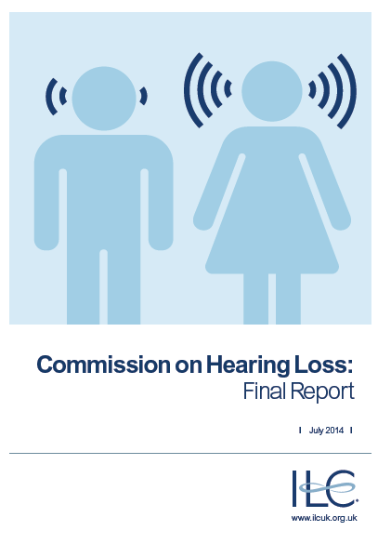
COMMISSION ON HEARING LOSS
Established by the International Longevity Centre UK
Chaired by Baroness Greengross; with membership of parliamentarians and sector experts.
Oral and written evidence from over thirty organisations and individuals
Supported by research by the ILC team

Slide 6
KEY QUESTIONS FOR THE COMMISSION
How and to what extent can hearing loss impact on a person’s quality of life?
What are the wider implications with regard to social isolation, loneliness and exclusion, employment and extending working life, equal access to health and social care?
What are the current barriers which prevent early detection and support of hearing loss?
How can we support people to recognise their hearing loss earlier and come forward for help?
How can we de-stigmatise hearing loss and the use of hearing aids?
How can public and private health and social care providers improve early detection and hearing services?

Slide 7
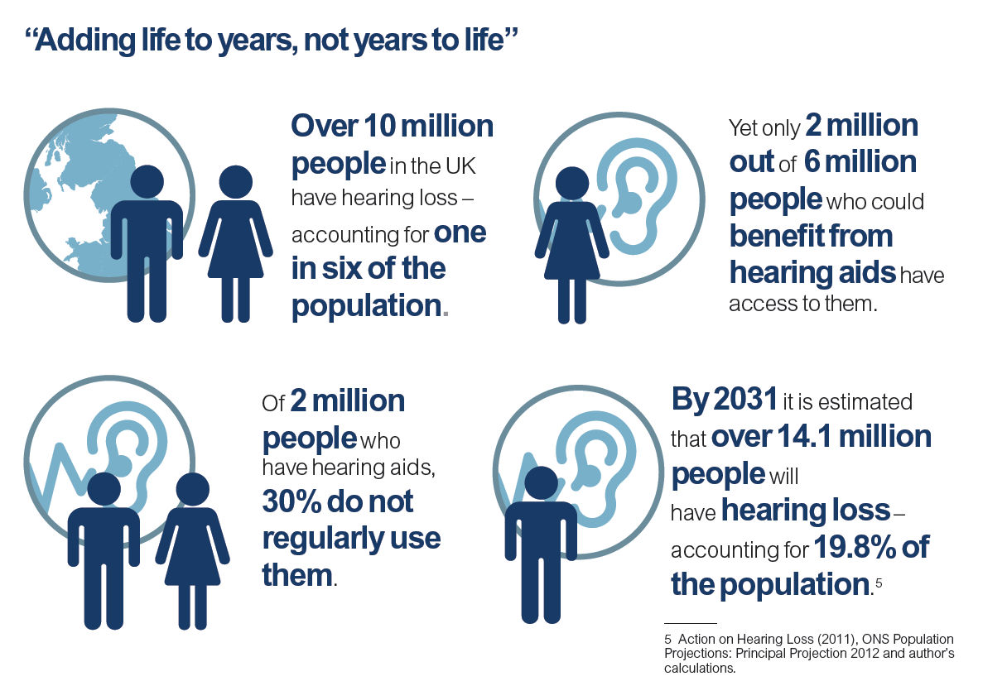
HEARING LOSS – THE BASIC STATS

Slide 8
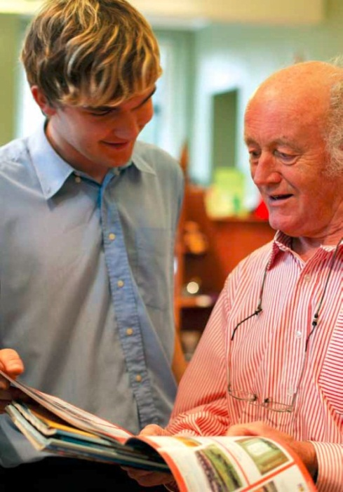
QUALITY OF LIFE
RELATED RESEARCH (1)
Hear-It (2006) Bridget Shield, London Southbank University:
16% of all Europeans has a hearing loss
55m adults in EU
Unaided hearing loss costs 170bn Euro
Hearing Problems and Working Life (2006) Christensen, Danish National Institute of Social Research:
Labour market and working life 50-64
360m Euro productivity loss

Slide 9
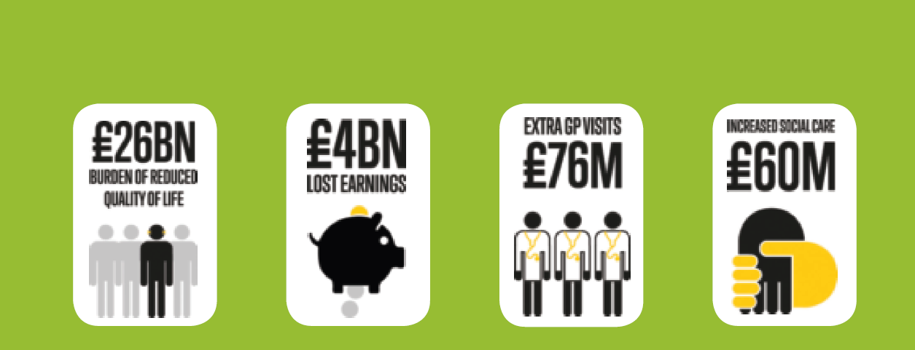
QUALITY OF LIFE
RELATED RESEARCH (2)
£30bn (37bn euros) per annum as the direct costs of treating hearing loss and of dealing with the health and social impacts.
Refers to health, mental health, mortality, cognitive function, social life and employment.

Slide 10
WIDER IMPLICATIONS –
SOCIAL ISOLATION
“Compared with the UK population, the rate of depression in our deafened participants was nearly five times higher, and in their hearing partners, just over four times higher. Rates for severe anxiety in our deafened participants were nearly two and a half times greater than the UK average, and for partners, over one and a half times greater.”
Link, the centre for deafened people (now Hearing Link), and the University of Greenwich (2005)

Slide 11

WIDER IMPLICATIONS - EMPLOYMENT
3.7m working age people with hearing loss in the UK.
4,000 member responses and 27 in depth case studies.
Less than half people told their colleagues, only 37% told their employer.
14% changed jobs as a result of their hearing loss.
36% who retired early did so directly because of their hearing loss.

Slide 12
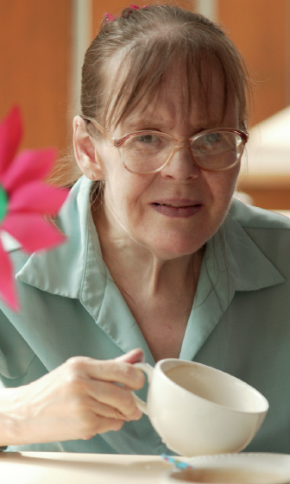
WIDER IMPLICATIONS –
HEALTH AND SOCIAL CARE
15 million people in the UK have long-term conditions.
Co-morbidities with dementia, cardiovascular disease, stroke, diabetes, Parkinson's disease and sight loss.
Big challenge to system to manage multiple long term conditions.

Slide 13

CURRENT BARRIERS TO EARLY DETECTION
Hearing loss has slow onset it takes on average 10 years before someone with hearing loss recognises that they have it and seeks support.
There is a stigma associated with hearing loss which acts to prevent people from seeking help. Hearing loss is seen as part of the ageing process
In order to have a hearing test from which an NHS hearing aid can be fitted, individuals must be referred by their GP. Yet 45% of people who go to their GP to seek help for their hearing loss, do not get referred on.

Slide 14
CONCLUSIONS – THE CHALLENGE
Major public health issue
Significant personal and economic cost
Wide implications
Barriers to action which are both personal and systemic

Slide 15
MAJOR RECOMMENDATIONS
1. Screening - National and opportunistic screening programmes
2. Transform hearing services
3. Publish and implement Hearing Loss Action Plan
4. National commissioning framework and NICE quality standards
5. Public health and public information campaign
6. Training for health and social care professionals
7. Employment – employer attitudes and Access to Work
8. Deaf and hearing loss awareness in public and institutional settings

Slide 16


RECOMMENDATION 1 - SCREENING
National Screening Programme
Hearing loss to be built into health check-ups and other opportunistic screening.
Pilots of alternative models such as self-referral.

Slide 17
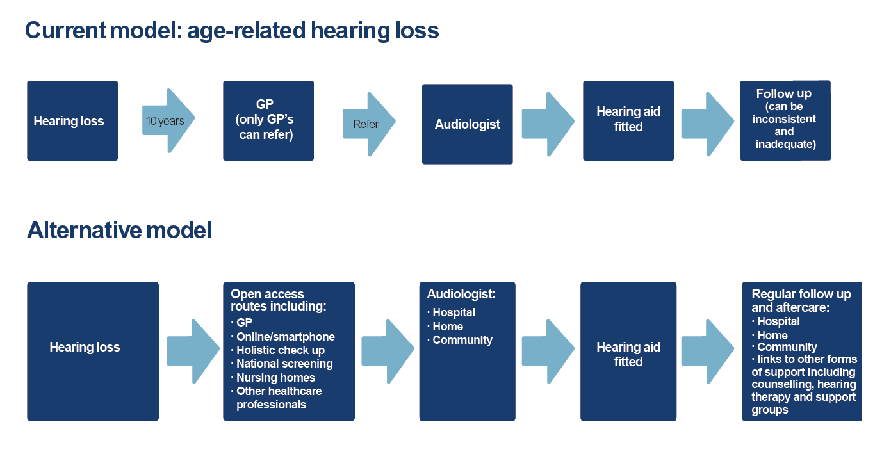
RECOMMENDATION 2 - TRANSFORM HEARING SERVICES

Slide 18
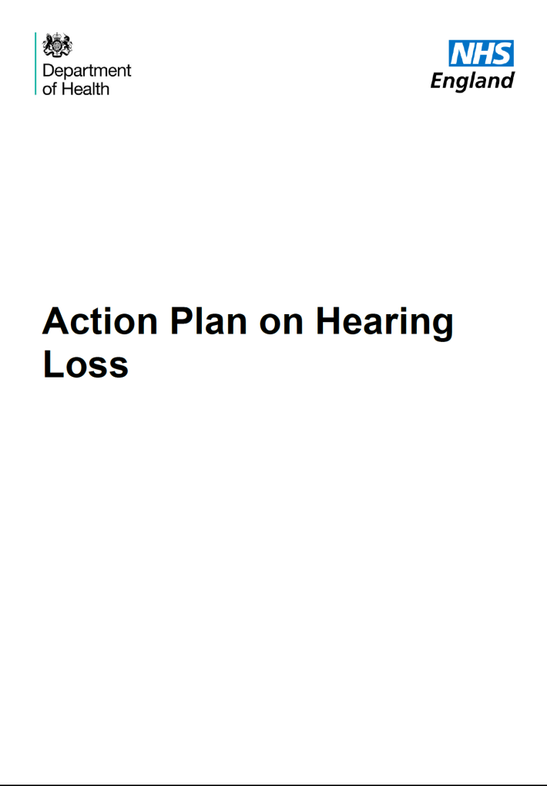
RECOMMENDATION 3 – PUBLISH AND IMPLEMENT ACTION PLAN
Published in March 2015
Now trying to secure clear implementation plan

Slide 19


RECOMMENDATION 4 – STANDARDS
Strategic direction is needed now - Government should publish the long-awaited Action Plan on hearing loss. But this must be allied to a national commissioning framework and an appropriate NICE quality standard to ensure high quality services are consistently provided, developed in consultation with patient groups, individuals and professionals – representing the public, private and third sector.

Slide 20

RECOMMENDATION 5 – PUBLIC HEALTH AND PUBLIC INFORMATION

Slide 21

RECOMMENDATION 6 – TRAINING FOR HEALTH AND SOCIAL CARE PROFESSIONALS

Slide 22

RECOMMENDATION 7 – EMPLOYMENT
Employer attitudes
Vital role for Human Resources teams
Access to work – reform and expansion

Slide 23
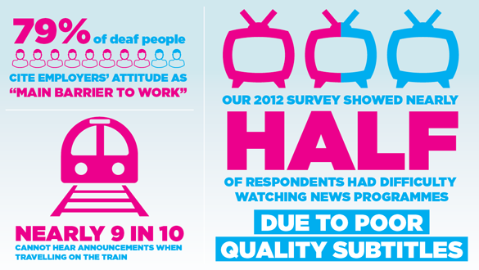
RECOMMENDATION 8 – DEAF AND HEARING LOSS AWARENESS

Slide 24
Any questions?

