Slide 1
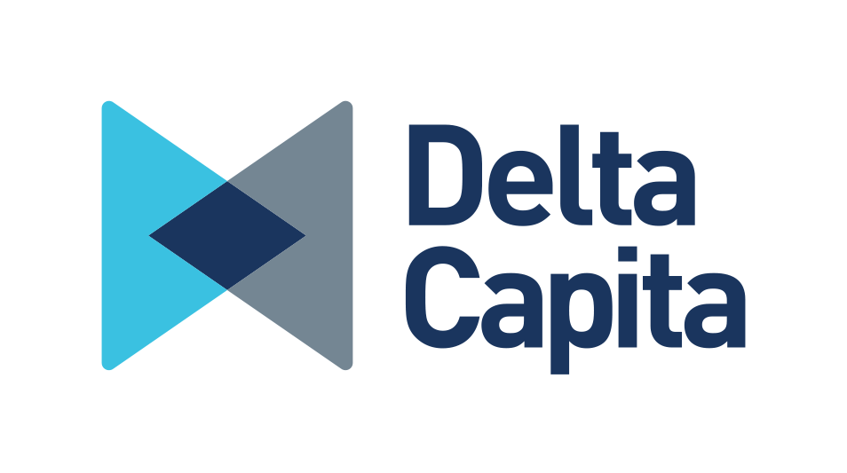
Voice Activation for Wealth Management
Huhan and Indika
© COPYRIGHT | Delta Capita | CONFIDENTIAL

Slide 2
Introduction
Aim – To develop a solution that will enable users to interact with CboeVest’s the wealth management platform through voice. A wealth Management Platform manager.
Sources:
Wealth Management Platform: a place where users manage their portfolio account (i.e. monitoring account performance, customize stock strategies)
Snips Voice Platform: a spoken language understanding system. ( https://arxiv.org/pdf/1805.10190.pdf )

Slide 3
Process Workflow
Raw audio input
ASR and LM models
text
NLU model
Intents
API
Slots
Requests
Cboe Vest Wealth Management Platform
System response to users
audio
Text to Speech engine
Constructed sentences
Chatbot
Key
Value
Visual updates in web page

Slide 4
Snips Voice Platform
Automatic Speech Recognition (ASR): hybrid Neural Network/Hidden Markov Model models. First step of the whole process, convert raw audio data into context-dependent clustered HMM state probabilities.
Language Model (LM): turns predictions of ASR model into likely sentences (via a Viterbi search algorithm)
Natural Language Understanding (NLU): extracts intent and slots from the sentences (via deterministic intent parser and probabilistic intent parser)
Notes:
Deterministic intent parser: this mainly relies on regular expression. Catches the patterns of sentences
Probabilistic intent parser: uses logistic regression on intent classification and conditional random fields on slots filling. Catches variations of sentences which do not appear in training

Slide 5
Challenges and Future Plan
The demo so far is restricted to certain use cases.
Generating larger dataset
Working on larger dataset, increase the generalizability of models
Expand the project and integrate voice with other projects(i.e. machine learning interpretability)

