Slide 1
www.womenindata.co.uk
#womenindata

Slide 2
Chatbot for social good and NLP in the wild

Slide 3
A little bit about me
I am a Data Scientist at AI for Good UK working to improve product intelligence and communicate findings with wider stakeholder groups and the founder of the AI for Good community here in London
Notes:
I am a Data Scientist at AI for Good UK working to improve product intelligence and communicate findings with wider stakeholder groups and the founder of the AI for Good community here in London
I graduated from the University of Cambridge in the summer of 2019 with a Masters of Engineering degree specialising in Machine Learning and Deep Learning.
I was the Deputy Director of the Cambridge Development Initiative an international development agency which runs four development projects in Tanzania each year. I was also the founder of the Engineering for Social Good group at Cambridge.

Slide 4
In this talk I am going to go through...
Survey of chatbot technologies
Main applications and some case studies of success and failure
The current state-of art and the progression to such
What is the future direction of this field
rAInbow our chatbot and the problems that we encountered
The story behind rAInbow - why is it an innovative solution
NLP work and progress
Future directions
AI for Social Good
Notes:
Survey of chatbot technologies with a focus on Natural Language Processing

Slide 5
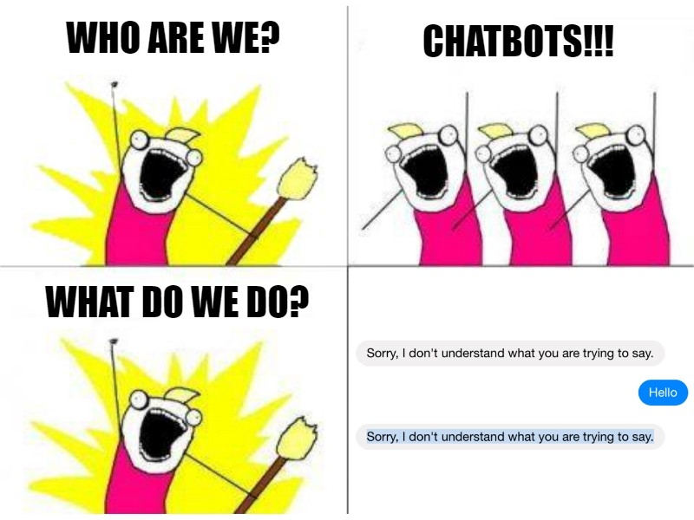
What is a chatbot?
NLP papers classify Conversational AI into three categories: question-answering agents, task-oriented dialogue agents and chatbots.
Wikipedia says: A chatbot is a piece of software that conducts a conversation via auditory or textual methods. Such programs are often designed to convincingly simulate how a human would behave as a conversational partner, although as of 2019, they are far short of being able to pass the Turing test.
Source: chatbot magazine
Notes:
Intelligent Conversational AI has been a long standing goals of AI and large amount of training data becoming available recent breakthroughs in Deep Learning and Reinforcement Learning applied to conversational AI shows great promise in both academia and industry.
The Turing test, developed by Alan Turing in 1950, is a test of a machine's ability to exhibit intelligent behaviour equivalent to, or indistinguishable from, that of a human.

Slide 6
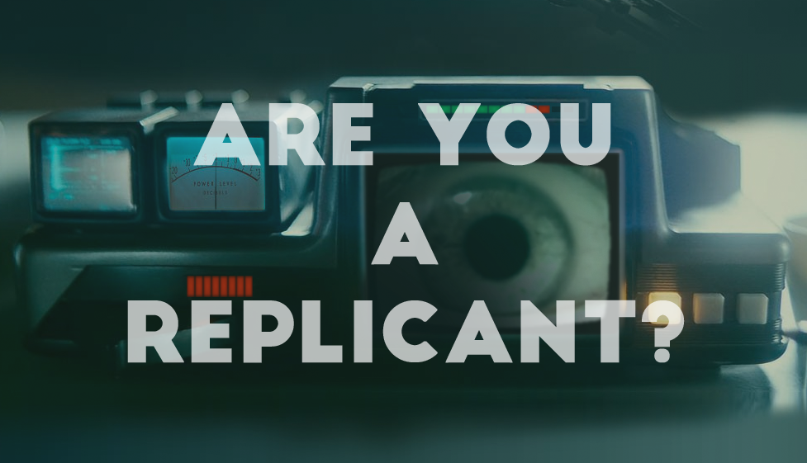
Turing Test
Source: BFI

Slide 7
Some prevalent use cases of chatbots
By Business Functions:
Customer Service
Marketing
Sales
HR
By Industry:
E-commerce
Travel
Finance

Slide 8
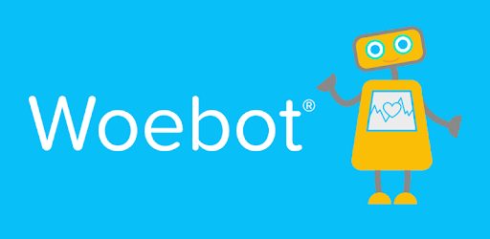
Successful Chatbot Applications
Social Chatbot Legal Chatbot Mental Health Chatbot
Source: Nautilus | Science Connected, Crunchbase, Google Play
Notes:
CBT-Cognitive Behavioural Therapy

Slide 9
Tech Stack behind Chatbot:
What makes them intelligent?

Slide 10
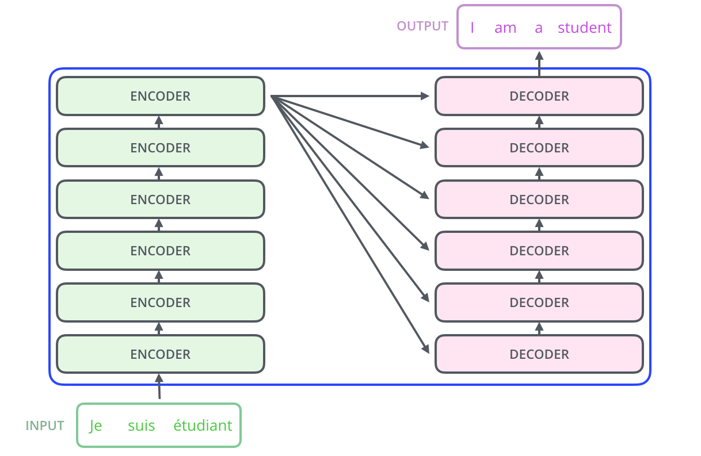
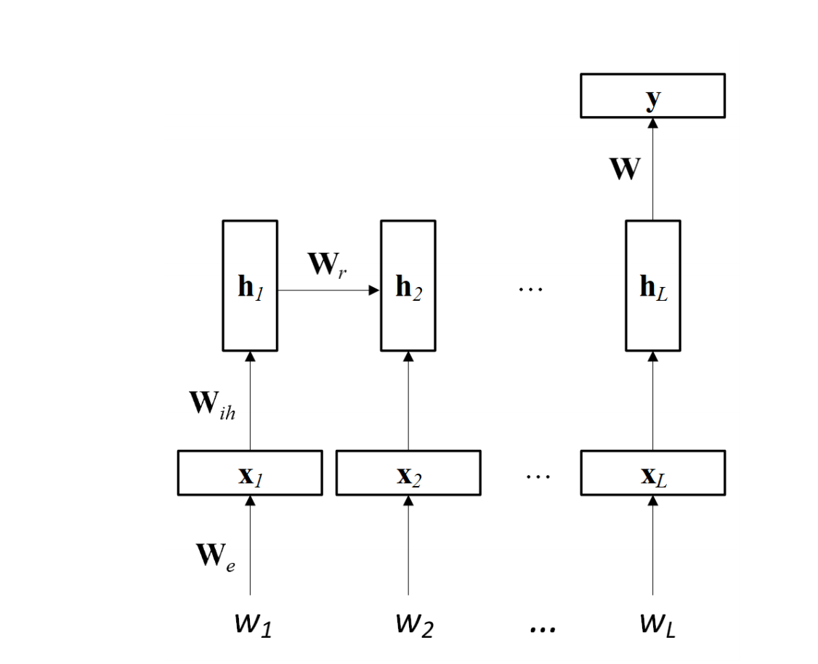
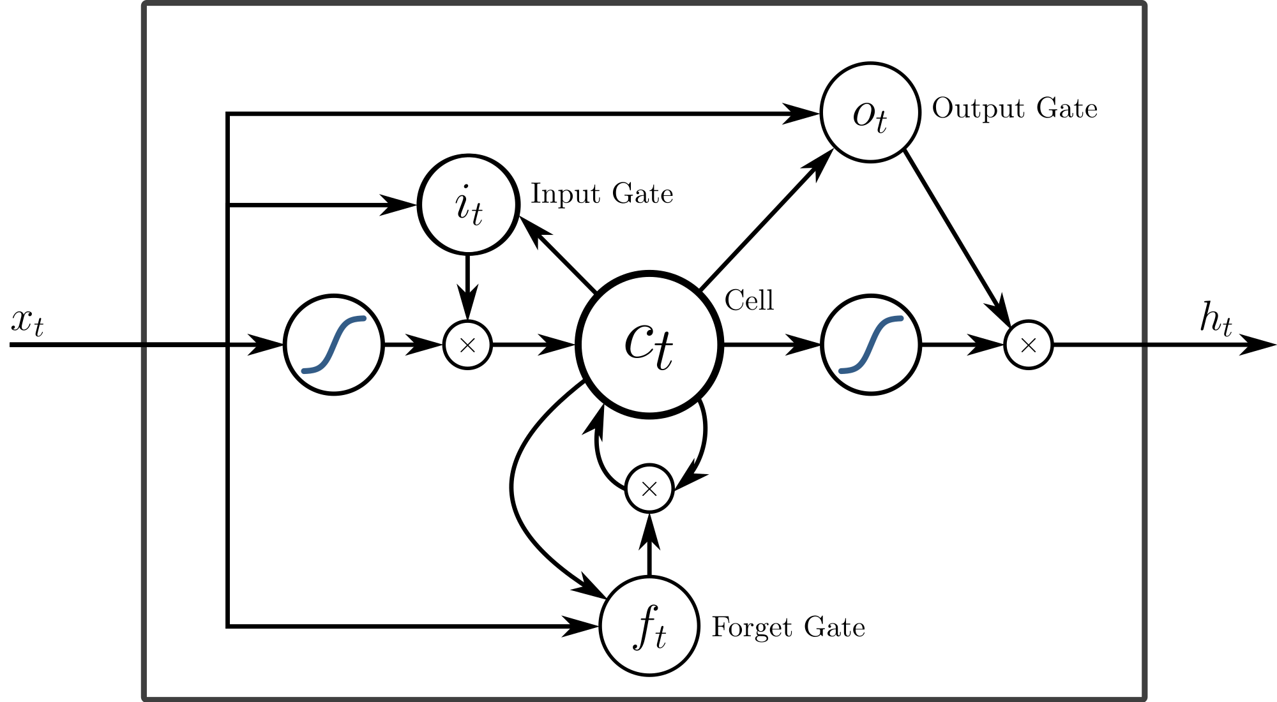
Some Natural Language Processing (NLP) Lingo
Intent: intentions of the end-user, these intentions or intents are conveyed by the user to your bot e.g. greeting,book_appointment
Entity: person names, organizations, locations, medical codes, time expressions, quantities, monetary values, percentages. Named-entity recognition is the technique to automatically identify these entities in free text.
Embedding: vectors, e.g. word embeddings
RNN, LSTM:
Source: Towards Data Science

Slide 11
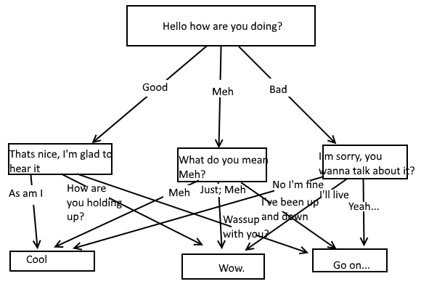
‘Lawful Good’ chatbot architecture
Source: Chatbot Magazine

Slide 12
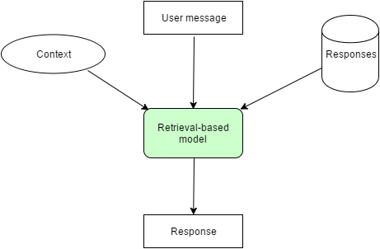
‘True Neutral’ chatbot architecture
Source: https://dzone.com/articles/understanding-architecture-models-of-chatbot-and-r

Slide 13
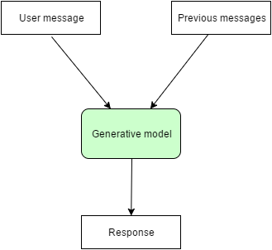
‘Chaotic Evil’ chatbot architecture
Source: https://dzone.com/articles/understanding-architecture-models-of-chatbot-and-r

Slide 14
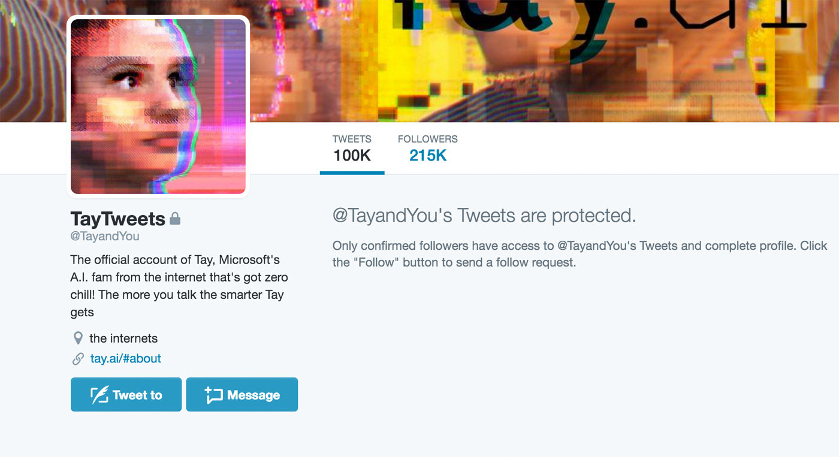
Generative model in the wild
Source: Engadget

Slide 15
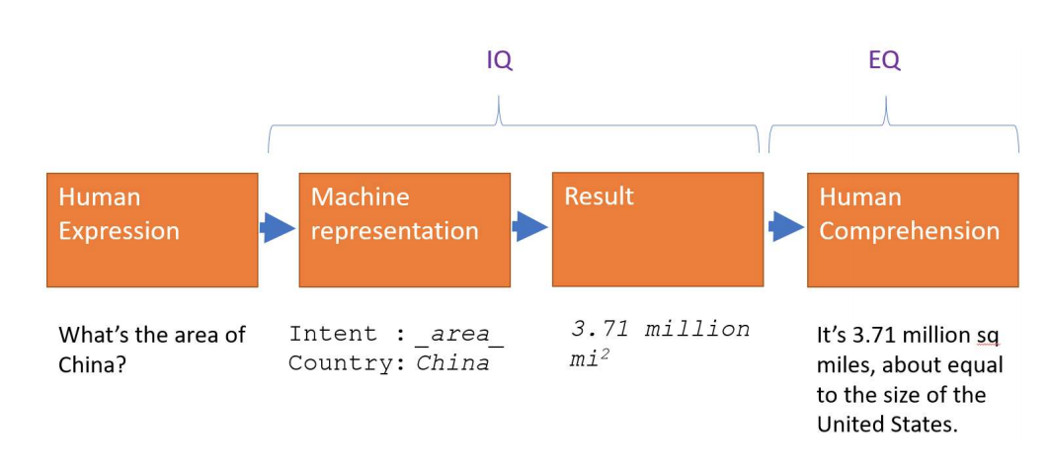
XiaoIce - a social chatbot
Wouldn’t be possible without advancement in NLU, Speech Recognition and Synthesis, Computer Vision, Information Retrieval, Multimodal intelligence and empathic conversational system.
Requirement of a social chatbot: Understanding users, Interpersonal response generation, Personality, Integration of both EQ and IQ
Source: https://arxiv.org/pdf/1801.01957.pdf
Notes:
Microsoft XiaoIce , arguably the most popular social chatbot that has attracted more than 660 million users worldwide since its release in 2014.

Slide 16
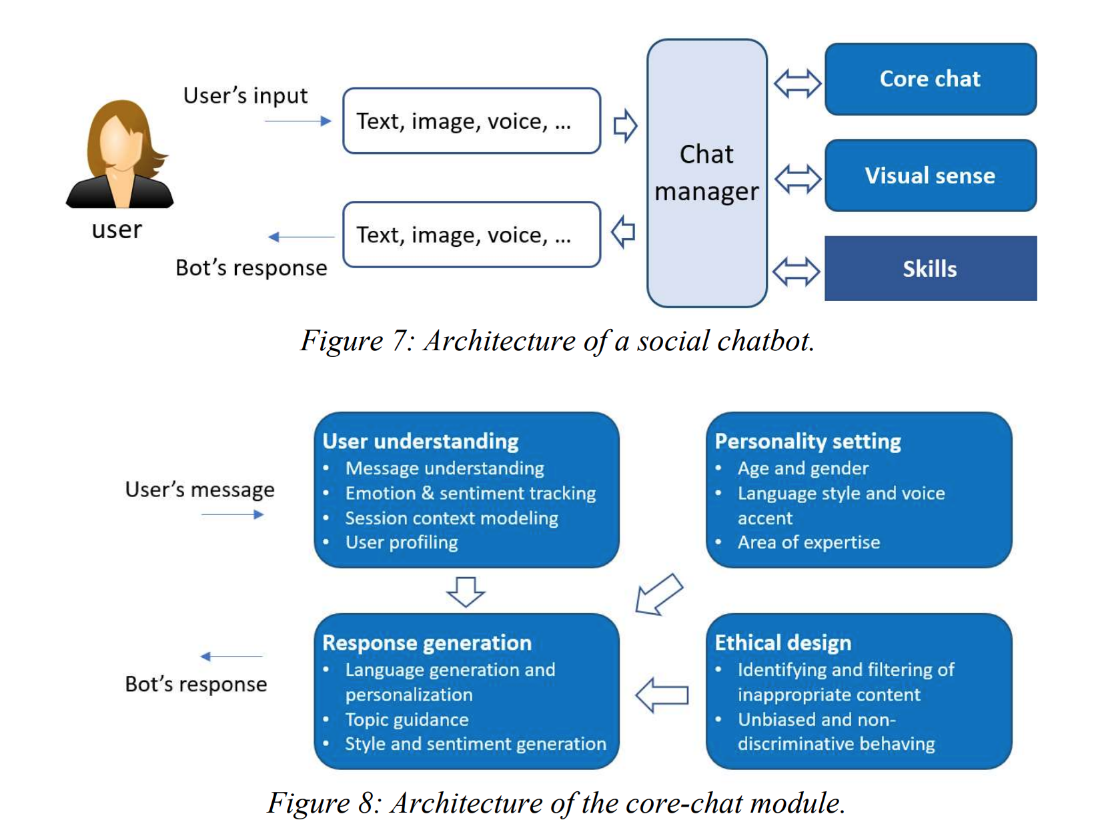
XiaoIce - continued
Source: https://arxiv.org/pdf/1801.01957.pdf
Notes:
Conversation-turns Per Session (CPS) XiaoIce has an average engagement of 23

Slide 17
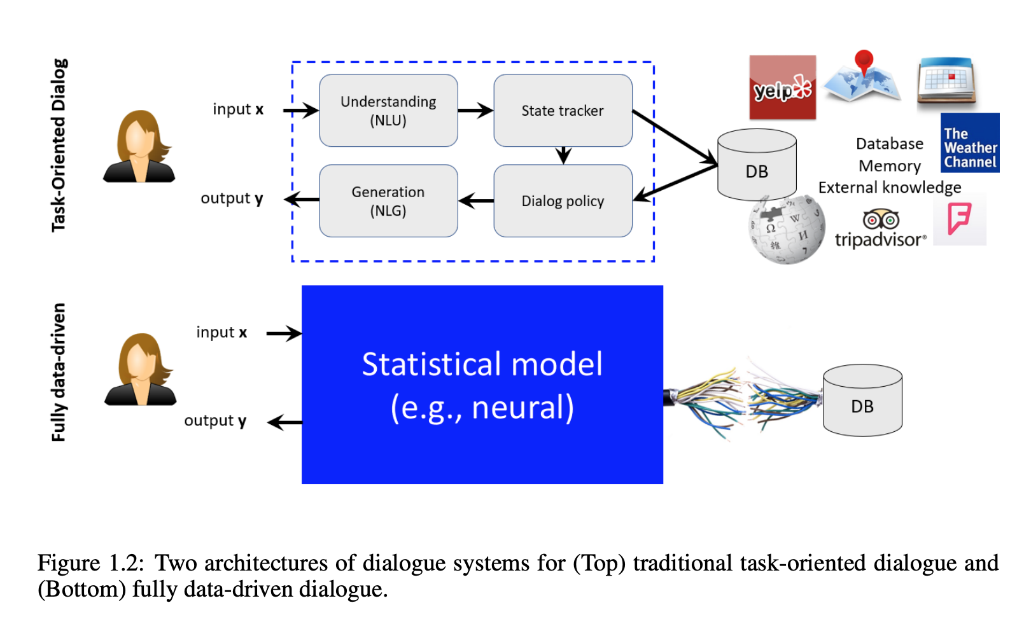
Neural Approaches to Conversational AI
Source: https://arxiv.org/pdf/1809.08267.pdf
Notes:
A typical task-oriented dialogue agent is composed of four modules, as illustrated in Fig. 1.2 (Top):
(1) a Natural Language Understanding (NLU) module for identifying user intents and extracting
associated information; (2) a state tracker for tracking the dialogue state that captures all essential
information in the conversation so far; (3) a dialogue policy that selects the next action based on the
current state; and (4) a Natural Language Generation (NLG) module for converting agent actions to
natural language responses. In recent years there has been a trend towards developing fully datadriven systems by unifying these modules using a deep neural network that maps the user input to
the agent output directly, as shown in Fig. 1.2 (Bottom).

Slide 18
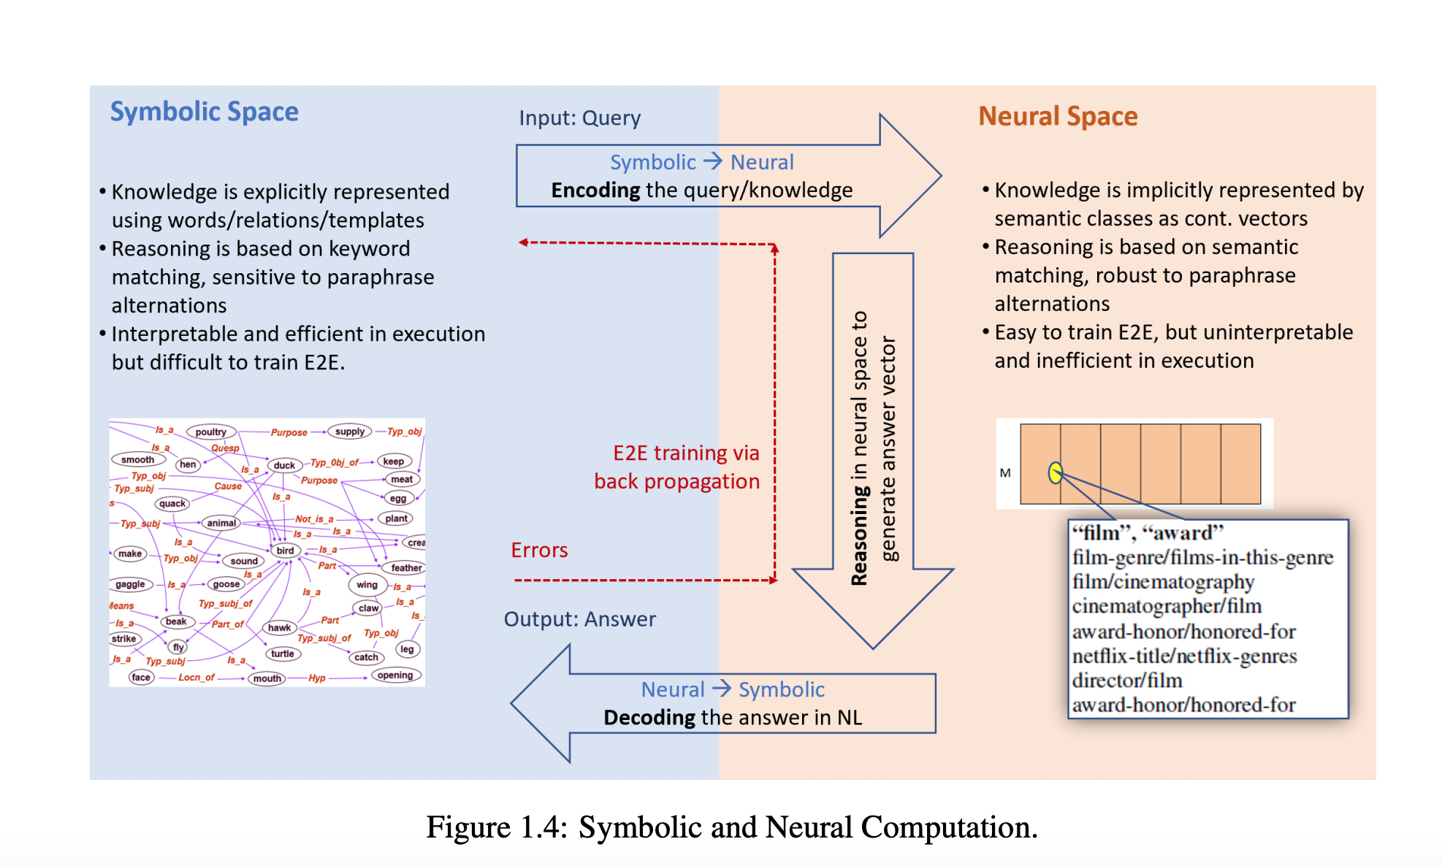
Neural Approaches to Conversational AI
Source: https://arxiv.org/pdf/1809.08267.pdf
Notes:
The Transition of NLP to Neural Approaches
Neural approaches do not rely on any human-defined symbolic representations but learn in a taskspecific neural space where task-specific knowledge is implicitly represented as semantic concepts
using low-dimensional continuous vectors. As Fig. 1.4 illustrates, neural methods in NLP tasks (e.g.,
machine reading comprehension and dialogue) often consist of three steps: (1) encoding symbolic
9
Figure 1.4: Symbolic and Neural Computation.
user input and knowledge into their neural semantic representations, where semantically related or
similar concepts are represented as vectors that are close to each other; (2) reasoning in the neural
space to generate a system response based on input and system state; and (3) decoding the system
response into a natural language output in a symbolic space. Encoding, reasoning and decoding are
implemented using neural networks of different architectures, all of which may be stacked into a
deep neural network trained in an end-to-end fashion via back propagation.

Slide 19
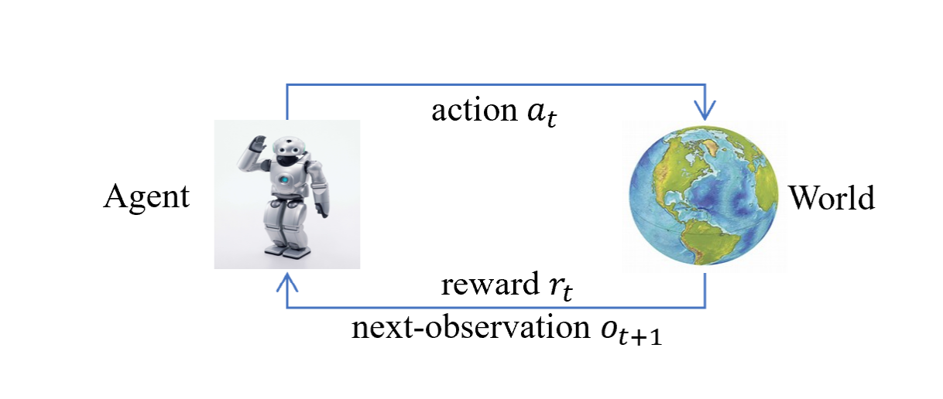
Neural Approaches to Conversational AI
Source: https://arxiv.org/pdf/1809.08267.pdf
Notes:
Dialogue can be casted into a decision making process: can be cast in the mathematical framework of options
over Markov Decision Processes (MDPs) If we view each option as an action, both top- and low-level processes can be naturally captured by the reinforcement learning framework. a top-level process selects what agent to activate for a particular subtask (e.g., answering a question, scheduling a meeting, providing a recommendation or just having a casual chat), and a low-level process, controlled by the selected agent, chooses primitive actions to complete the subtask. The dialogue agent navigates in a MDP, interacting with its environment over a sequence of discrete steps. At each step, the agent observes the current state, and chooses an action according to a policy. The agent then receives a reward and observes a new state, continuing the cycle until the episode terminates. The goal of dialogue learning is to find optimal policies to maximize expected rewards.

Slide 20
Meanwhile… standard industry toolbox -True Neutral
Source: pickSaaS, WikiPedia

Slide 21
A COMPANION FOR WOMEN AT RISK
OF DOMESTIC VIOLENCE

Slide 22
rAInbow Awards
“
I know you do this with no thought of praise or reward, but allow me to offer my own recognition of the innovative solutions you have helped to create with the power of AI. From providing mental health support to adolescents in low income countries, to confidential chatbots that signpost support services to hundreds of thousands of women at risk of domestic abuse.
- UK Prime Minister
”
Notes:
Our projects and mission are supported by

Slide 23
Research phase - South Africa
Notes:
THE ISSUE
SA has really high abuse rates- 1 in 3 women experience abuse in their lifetime and Femicide rate is 5x higher in south Africa.
The reporting rate is low due to STIGMA, lack of TRUST in the police, lack of support, fear. Only 0.3% of these victims report it to the police. 1 in 25 rape cases get reported
THE ASK
Victims don’t want to be judged
They want someone to talk to whenever they feel like, and at their own pace
They don’t want to walk into a support service or pick up the phone as they are scared of the stigma around abuse

Slide 24
Stigma, shame,
victim blaming
Barriers to accessing support
Lack of trust in support system
A non-judgemental companion
Need
24/7
support
User-friendly experience and support
Notes:
THE ISSUE
SA has really high abuse rates- 1 in 3 women experience abuse in their lifetime and Femicide rate is 5x higher in south Africa.
The reporting rate is low due to STIGMA, lack of TRUST in the police, lack of support, fear. Only 0.3% of these victims report it to the police. 1 in 25 rape cases get reported
THE ASK
Victims don’t want to be judged
They want someone to talk to whenever they feel like, and at their own pace
They don’t want to walk into a support service or pick up the phone as they are scared of the stigma around abuse

Slide 25
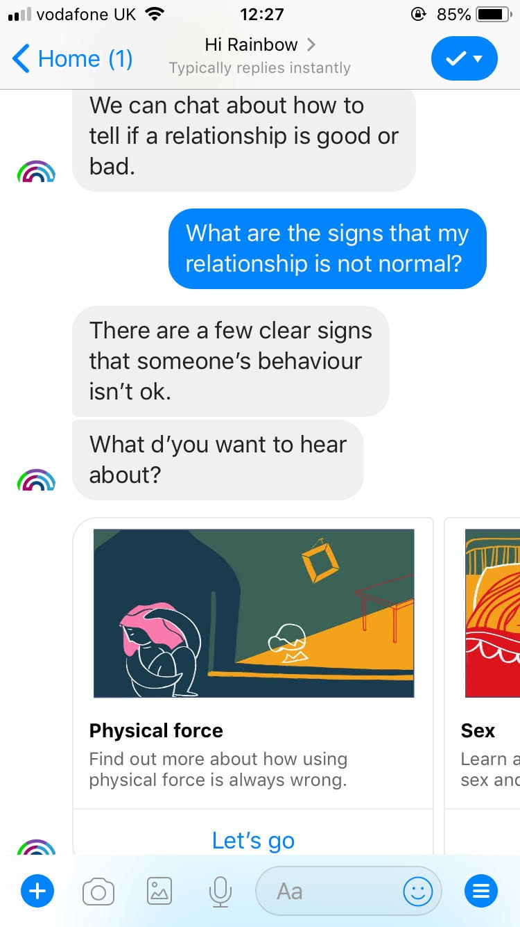
Hi Kriti, I’m Rainbow, but my friends call me Bo
I’m here to talk about relationships that don’t feel right.
This is how you’d interact with me…
Notes:
rAInbow is an online chat we created that offers a friendly, non-judgemental conversations and provide emotional support and information to anyone experiencing abuse. Although most of us use the internet as our primary source of information and research, when it comes to abuse and violence, there is a gap in reliable information and support available online. We launched rAInbow in South Africa on November 2018. In 8 month.
rAInbow is a prevention mechanism designed to help potential victims, their family and friends detect early signs of abuse. Our impact model ensures that rAInbow’s conversation flow and educational content make a positive difference to the victims. We measure this through impact assessment modules embedded intuitively within the user experience through engaging quizzes with over 65% completion rate. We aim to ultimately reduce abuse incidents by making early, proactive and predictive interventions.

Slide 26
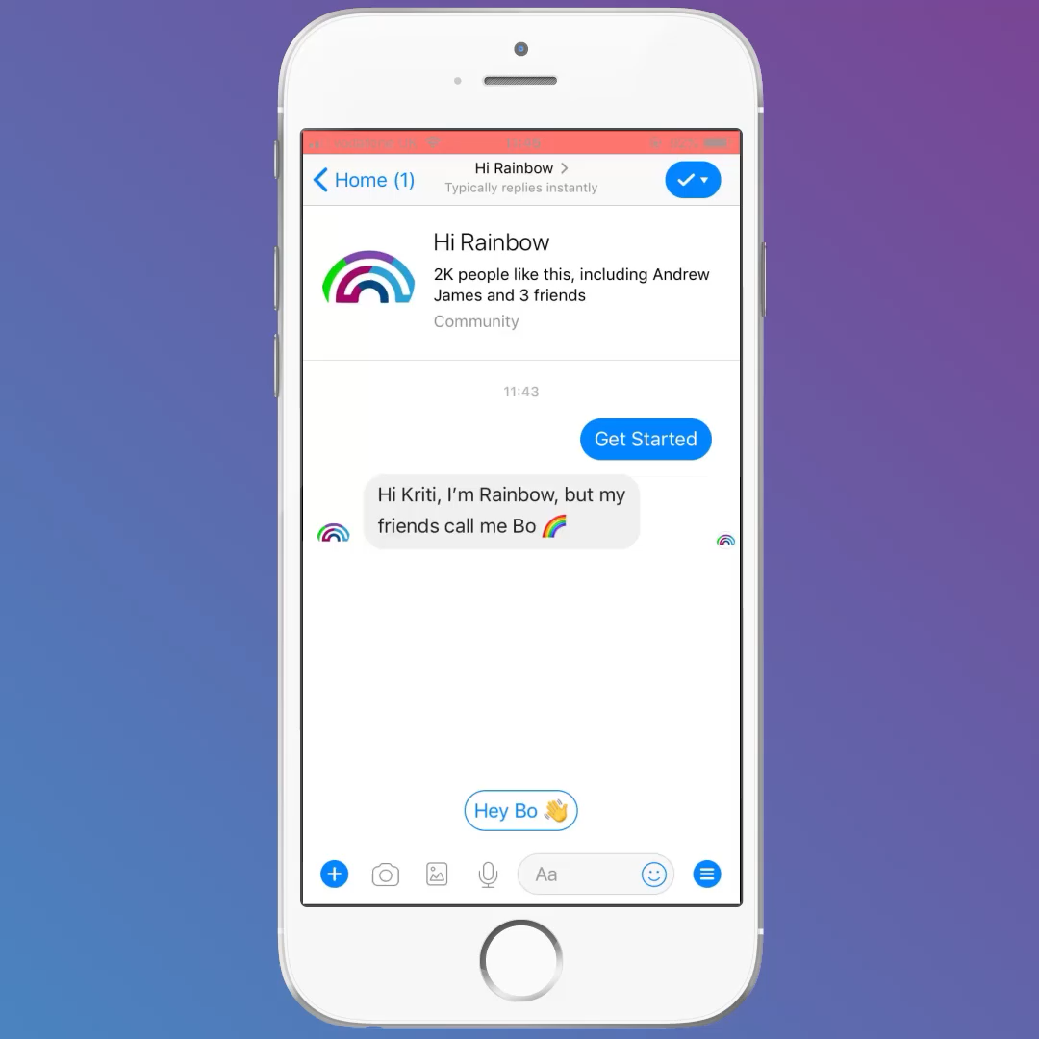
Notes:
TALK TO BO – Play video in the background and continue explaining how rainbow is a friendly companion, the language we use is simple so anyone can engage, non-judgemental so no one feels they can’t talk to rainbow.
Also – people don’t know it’s abuse! How Bo, through conversation, helps identify what types of abuse and the next steps.
We used targeted FB advertising to reach our audience.

Slide 27
rAInbow user insights
Notes:
The results – reinforced what we already knew.
It validated what we had heard from victims during our consultation, and what we knew based on our research and the culture of abuse in SA.

Slide 28
350,000 conversations
in 8 months (Nov 2018)
Notes:
The results – reinforced what we already knew.
It validated what we had heard from victims during our consultation, and what we knew based on our research and the culture of abuse in SA.

Slide 29
6-10AM and 7-8PM
peak hours on rAInbow
9AM to 5PM
helpline hours
Notes:
We received 3x the number of messages during these hours than in other hours of the day.
Assumption - people were talking to us before going to work and after.
Helplines don’t support this demand because they function 9-5

Slide 30
Saturdays 10% increase
Sundays 15% increase
in conversations
Monday to Friday
helpline days
Notes:
Would it be possible to create a simple, animated graph of the one we have here, showing the line moving during the times of the day?

Slide 31
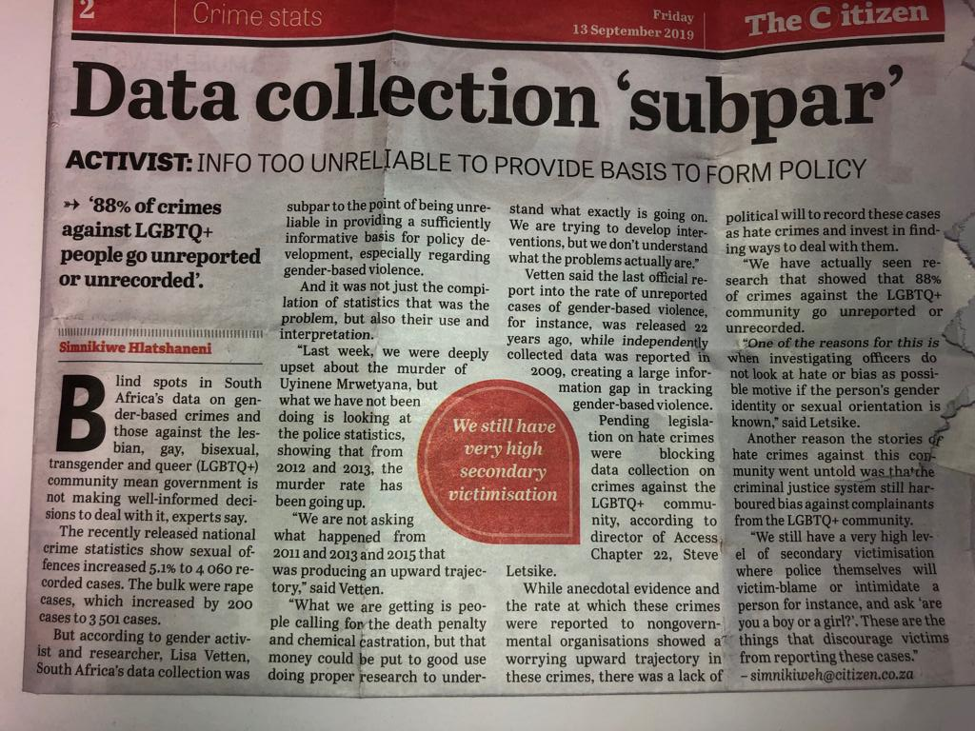
Better Data
Better Lives
Accurate data is the lifeblood of good policy and decision-making.”
- UN Secretary-General António Guterres
“
”
Notes:
Our projects and mission are supported by

Slide 32
350,000 conversations
with
14,000 users
Notes:
The results – reinforced what we already knew.
It validated what we had heard from victims during our consultation, and what we knew based on our research and the culture of abuse in SA.

Slide 33
Data Science insights
Notes:
The results – reinforced what we already knew.
It validated what we had heard from victims during our consultation, and what we knew based on our research and the culture of abuse in SA.

Slide 34
Engaged conversations
average 60 messages
average 20 minutes
more than half returned
Notes:
We received 3x the number of messages during these hours than in other hours of the day.
Assumption - people were talking to us before going to work and after.

Slide 35
What users want
personal conversations
at their own pace
in their own time
Notes:
This showed us there needs to be a shift in support – what users want is not ALWAYS what traditional services are offering. In particular in the initial stages. And if we want to end domestic abuse, we need PREVENTION and EARLY INTERVENTION. We need to stop the problem from happening, rather than investing only on supporting those who are already experiencing.
everyone has a trusted companion that helps them navigate difficult relationships and prevents them from getting into a bad place

Slide 36
”My relationship doesn’t feel right”
how most people describe abuse
abuse, violence, rape
how services are advertised
Notes:
Users aren’t necessarily seeking help – they want someone to talk to because ‘their relationship doesn’t feel right’

Slide 37
Users who engage with Bo through AI-powered personalised stories are
than those who don’t
40% more likely to take action
Notes:
rAInbow’s nudging effect

Slide 38
NLP Research Challenges
English proficiency of users - a variety of grammar and spelling - off-the-shelf tools do not work
Specific domain - less data - low transferability
Notes:
The results – reinforced what we already knew.
It validated what we had heard from victims during our consultation, and what we knew based on our research and the culture of abuse in SA.

Slide 39
NLP Research Current Progress
Unsupervised learning can only carry you so far - no free lunch in NLP
Tagging is difficult - what categories, intents, entities, sentiments to tag?
Notes:
The results – reinforced what we already knew.
It validated what we had heard from victims during our consultation, and what we knew based on our research and the culture of abuse in SA.

Slide 40
NLP Research Future Directions
Deep learning approaches for domestic abuse reporting message identification to enable human handover
Graph-based NLP approach to cluster sentences for new topics and themes mining
Notes:
The results – reinforced what we already knew.
It validated what we had heard from victims during our consultation, and what we knew based on our research and the culture of abuse in SA.

Slide 41
A few words about AI for Social Good
Meetup communities: AI for Good Community, AI for Good: Element AI, Microsoft: Impactful AI, Tech for Good London...
Companies and organisations to follow: AI for Good, Element AI, DataKind UK, Alan Turing Institute...
Conferences and workshops to watch: AI for social good, AI for Climate Change
Notes:
I am a Data Scientist at AI for Good UK working to improve product intelligence and communicate findings with wider stakeholder groups and the founder of the AI for Good community here in London
I graduated from the University of Cambridge in the summer of 2019 with a Masters of Engineering degree specialising in Machine Learning and Deep Learning.
I was the Deputy Director of the Cambridge Development Initiative an international development agency which runs four development projects in Tanzania each year. I was also the founder of the Engineering for Social Good group at Cambridge.

Slide 42
FREE TO ATTEND

