Slide 1
Complexity Science Workshop
Friday 19th June 2015
Professor David W Stupples
Future Systems Surveillance Technology

Slide 2
Route map for this talk
Introduction to drone technology
Essential radar theory for today’s talk
Radar cross section area (RCS) - coherent processing interval and pulse compression
Ubiquitous radar intro – aka staring radar
Ubiquitous radar (UR) as a system
UR signal processing – the magic of the system
Intro to the radar data cube
Extensions to the cube
STAP for UR

Slide 3
Drone Threat to Society
The amazing variety of drone shapes, sizes and capabilities reflects the diversity of the missions they are designed to carry out. Some are engineered primarily to provide surveillance, whereas others are armed. There are jet-powered drones nearly as large and fast as commercial airplanes that can be quickly deployed to locations hundreds or even thousands of kilometers away, and large blimps that can sit in the sky for months on end surveying hundreds of square kilometers at a time.
But it is the small drones that have the greatest potential to impact national security and privacy, because they can be easily acquired and transported and can be almost undetectable when they fly.

Slide 4
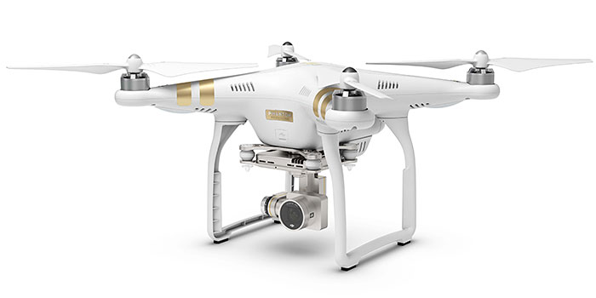
Typical Surveillance Drone – Phantom 3
Typical radar cross section (RCS)
C130 Hercules – 80m²
F16 Fighter with reduced RCS – 1m²
F18 Super Hornet – 0.1²
F35 Lightning II – 0.005m²
Phantom 3 Drone – 0.0005m²
Insect – 0.00001m²
As well as being difficult to see with the human eye or using electro-optical systems, small, composite UAVs have a small radar cross-section (RCS), and as they fly slowly and at low altitudes they easily blend into surrounding clutter. A typical radar would not see them.

Slide 5
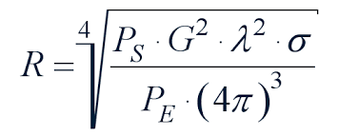
Radar Range Equation
The basic radar range equation is as follows:
However, the ubiquitous radar is a different beast and we need to take much more notice of the dwell factor, and so:

Slide 6
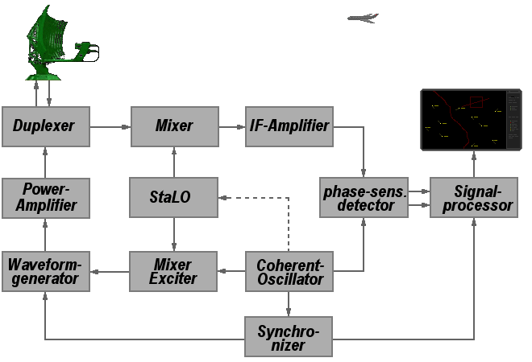
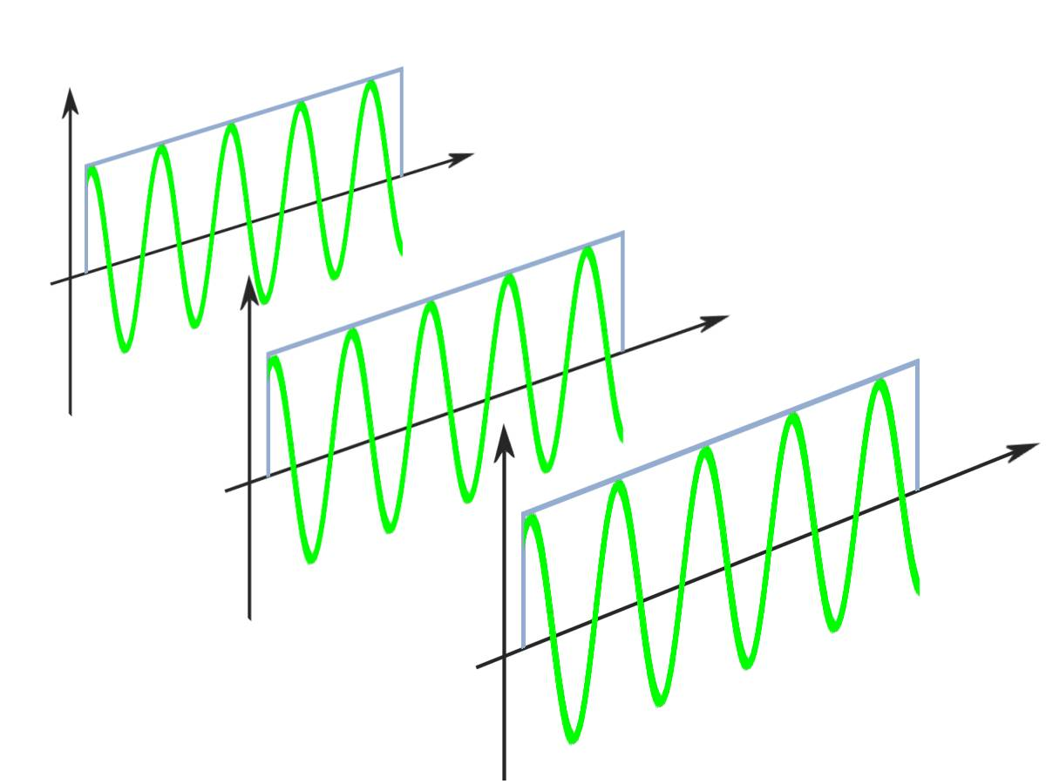
Coherent Radars

Slide 7
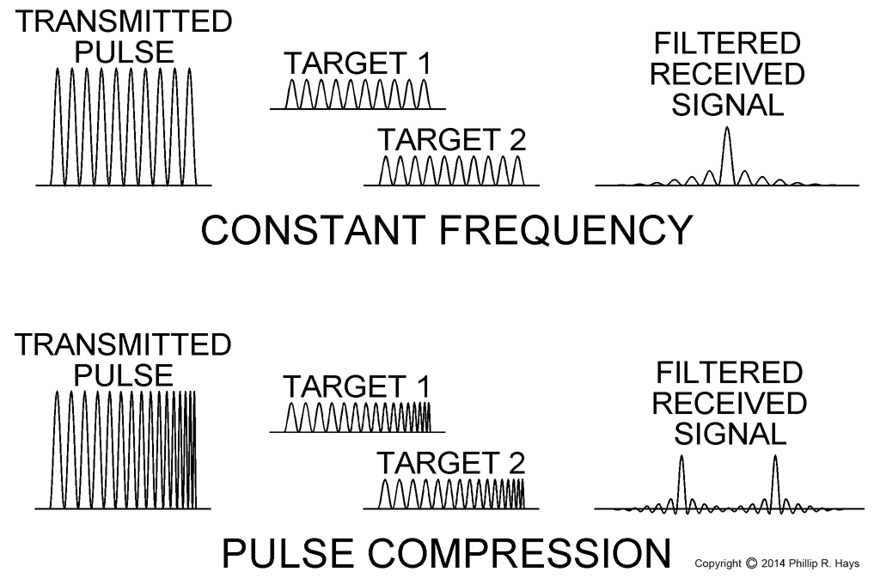
Pulse compression
A linear or chirp pulse
The SNR is proportional to pulse duration T, if other parameters are held constant. This introduces a tradeoff: increasing T improves the SNR, but reduces the resolution, and vice versa; as:

Slide 8
Doppler – needs to be very sensitive
Electric field of a transmitted wave
Returned electric field at some later time back at the radar
Time it took to travel
Substituting:
Received frequency can be determined by taking the time derivative if the quantity in parentheses and dividing by 2p

Slide 9
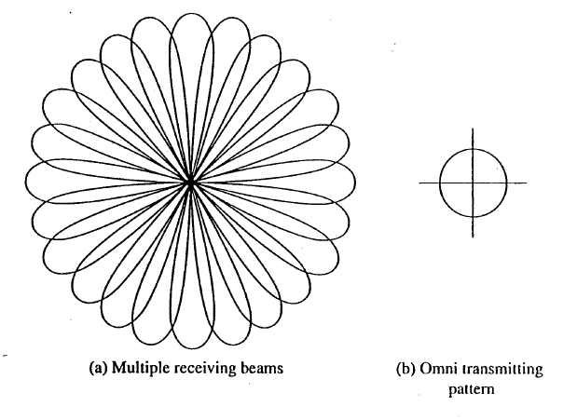
Ubiquitous Radar – aka Staring Radar
A ubiquitous radar is one that looks everywhere all the time. It does this by using a low-gain omnidirectional or almost omnidirectional transmitting antenna and a receiving antenna that generates a number of contiguous high- gain fixed (non-scanning) beams, as sketched

Slide 10
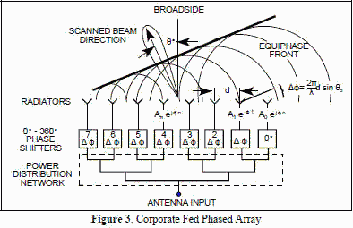
Radar broadside array
UR has digital beam forming – shown to
demonstrate philosophy

Slide 11
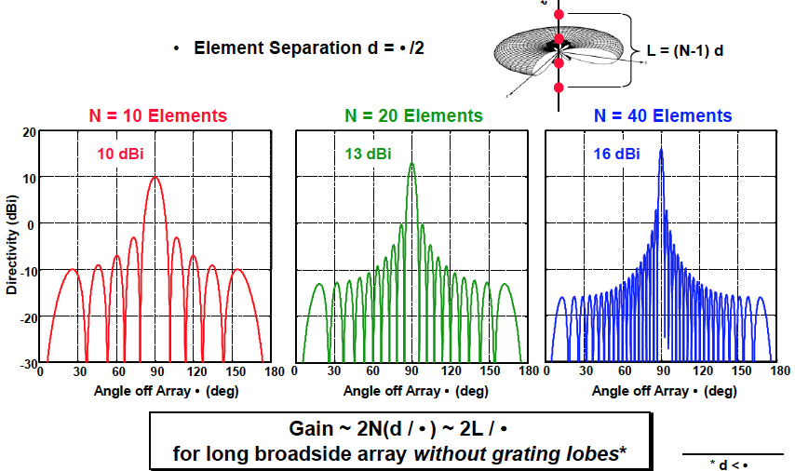
Achieving receiver gain

Slide 12
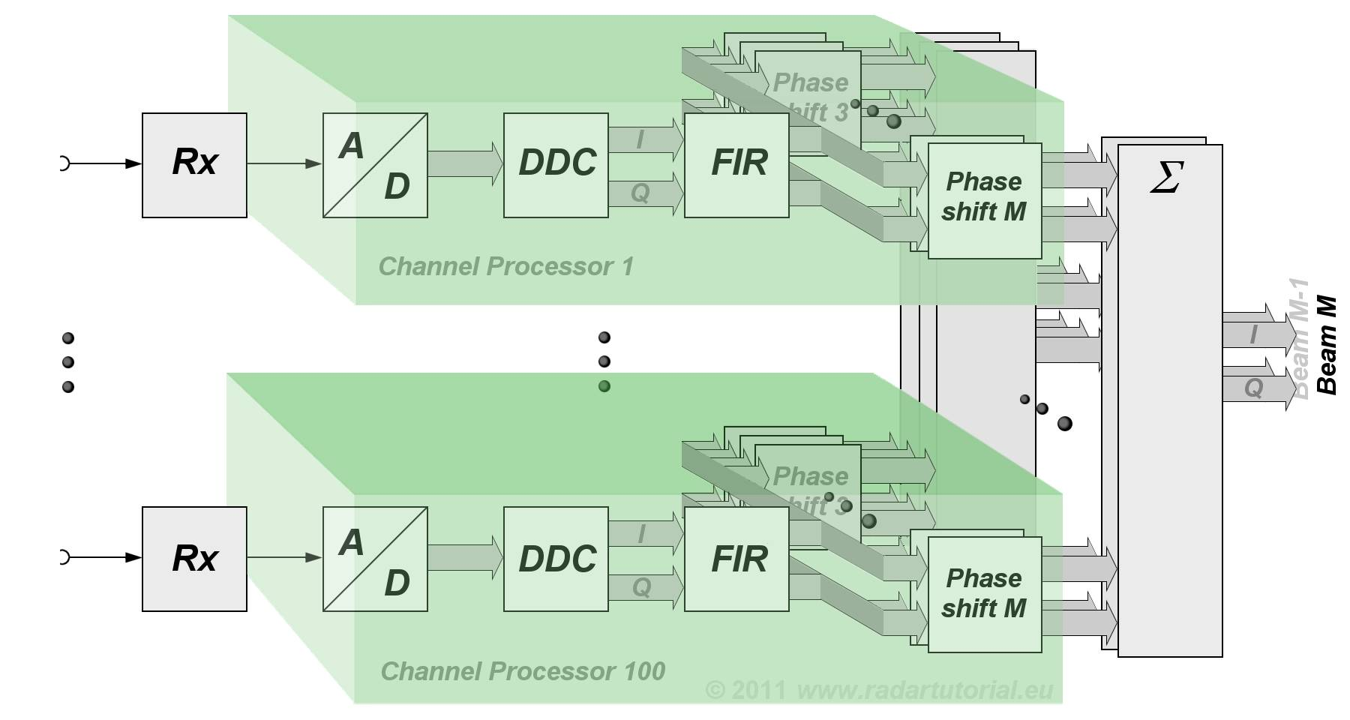
Digital beam forming for UR

Slide 13
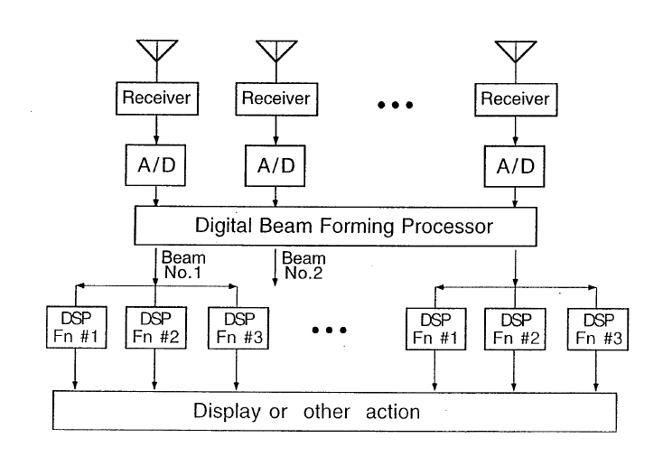
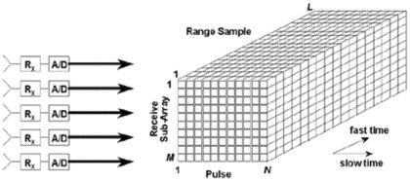
Ubiquitous Radar - 2

Slide 14
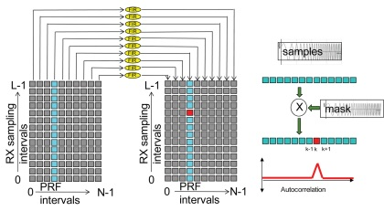
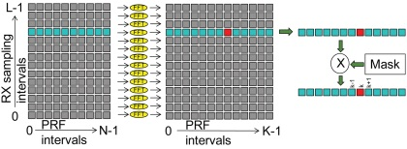
Expanded view of the processing - UR

Slide 15
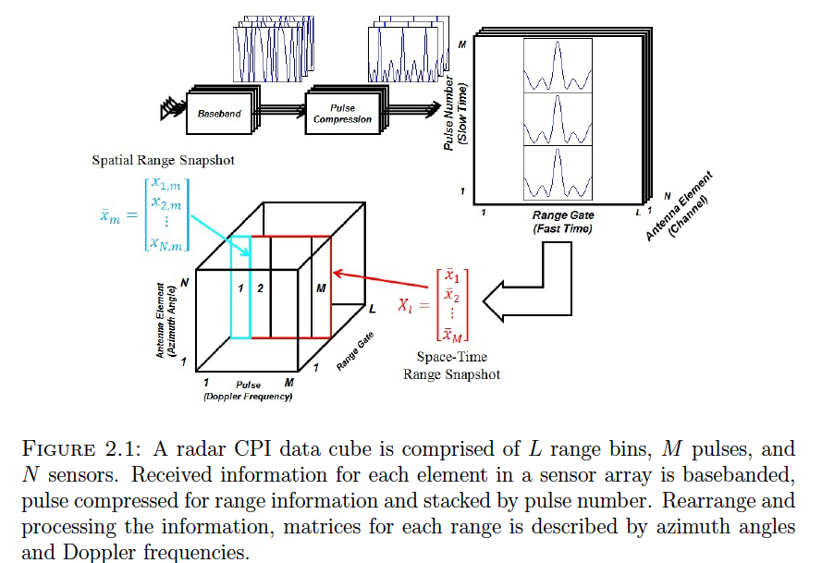
Radar data cube- expanded

Slide 16
UR using STAP – City University research
Space-time adaptive processing (STAP) refers to the simultaneous processing of the signals from an array antenna during a multiple pulse coherent waveform. STAP can provide improved detection of very low velocity targets obscured by mainlobe clutter, sidelobe clutter, and jamming through two dimensional processing, that enhances the ability of radars to detect targets that might otherwise be obscured by clutter or by jamming. This approach uses processing in both the time and spatial domain. Till now the algorithms were based upon the first order statistical characteristics of the echo. But STAP uses the second order statistics. This is because the determination of a target in a particular cell is no longer confined to a look into a linear array of cells, rather the targets are determined using information about adjacent cells in both dimensions.

Slide 17
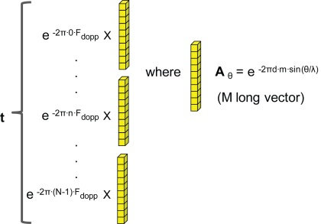
STAP for U Radar – modelling (1)
For each suspected target, a target steering vector must be computed. This target steering vector is formed by the cross product of the vector representing the Doppler frequency and the vector representing the antenna angle of elevation and azimuth. For simplicity, we will assume only azimuth angles are used.
The Doppler frequency offset vector is a complex phase rotation: F_{d} = e ^{-2π·n·F}_{dopp} for n = 1..N-1 The spatial angle vector is also a phase rotation vector: A _{θ} = e ^{-2πd·m·sin(θ/λ)} for m = 1..M-1, for given angle of arrival θ and wavelength λ The target steering vector t is the cross product vector F_{d} and A _{θ}, and t is vector of length N · M. This must be computed for every target of interest.

Slide 18
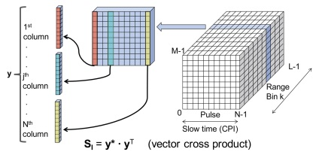
STAP for U Radar – modelling (2)
Next, the inference covariance matrix S_{I} is estimated. A column vector y is built from a slice of the radar data cube at a given range bin k. The covariance matrix by definition will be the vector cross product. S_{I} = y* · y^{T}
Here, the vector y is conjugated and then multiplied by its transpose. As y is of length N · M, the covariance matrix S_{I} is of size [(N · M) x (N · M)]. All data and computations are performed with complex numbers, representing both magnitude and phase. An important characteristic of S_{I} is that it is Hermitian, which means that S_{I} = S_{I}*^{T} or equal to its conjugate transpose. This symmetry is a property of covariance matrices.
S_{Interference} = S_{noise} + S_{jammer} + S_{clutter}

Slide 19
STAP for U Radar – modelling (2)
The covariance matrix is difficult to model, therefore it is estimated. Since the covariance matrix is used to compute the optimal filter, it should not contain the target data. Therefore, it is not computed using the range data right where the target is expected to be located. Rather, it uses an average of the covariance matrices at many range bins surrounding, but not at the target location range. This average is an element by element average for each entry in the covariance matrix, across these ranges. This also means that many covariance matrices need to be computed from the radar data cube. The assumption is that the clutter and other unwanted signals are highly correlated to that at the target range, if the difference in range is reasonably small.
The estimated covariance matrix can used to build the optimal filter.

Slide 20
STAP for U Radar – modelling (3)
The steps are as follows: S_{I} · u = t*, or u = S_{I}⁻¹ · t* One method for solving for S_{I} is known as QR Decomposition, which we will use here. Another popular method is the Choleski Decomposition. Perform the substitution S_{I} = Q · R, or product of two matrices. Q and R can be computed from S_{I} using one of several methods, such as Gram-Schmidt, Householder Transformation, or Givens Rotation. The nature of the decomposition in to two matrices is that R will turn out to be an upper triangular matrix and Q will be an orthonormal matrix, or a matrix composed of orthogonal vectors of unity length. Orthonormal matrices have the key property of: Q · Q^{H} = I or Q⁻¹ = Q^{H} Q · R · u = t* now multiply both sides by QH R · u = Q^{H} · t*

Slide 21
STAP for U Radar – modelling (4)
Since R is an upper triangular matrix, u can be solved by a process known as “back substitution”. This is started with the bottom row that has one non-zero element, and solving for the bottom element in u. This result can be back-substituted for the second to bottom row with two non-zero elements in the R matrix, and the second to bottom element of u solved for. This continues until the vector u is completely solved. Notice that since the steering vector t is unique for each target, the back substitution computation must be performed for each steering vector. Then solve for the actual weighting vector h: h = u / (t^{H}· u*), where dot product (t^{H}· u*) is a weighting factor (this is a complex scalar, not vector) Finally solve for the final detection result z by the dot product of h and the vector y from the range bin of interest. z = h^{T} · y Where z is a complex scalar, which is then fed into the detection threshold process.

Slide 22
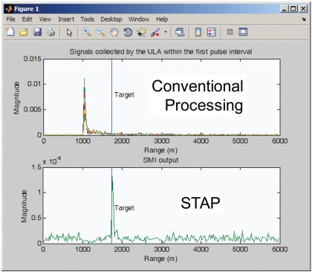
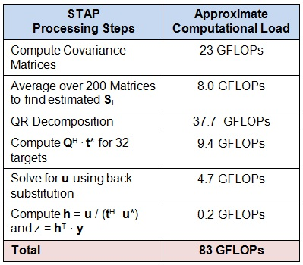
STAP for U Radar – modelling (5) result
The current experimental ubiquitous radar has 60 receive elements per segment, therefor requiring > 20 teraflops of real-time floating point processing power and in excess of 120 FPGAs.

